Slide 1
Weekly Progress
Classification comparison between different columns groups and sorting methods
Compare supervise & unsupervised encoder together
Checking empty column while slicing continuous data to binary
A axis-rearrange method to level the categorical variable range
Considering PCA in selecting columns groups
Considering different data generation
New fitness function for GA encoder
Notes:
fitness

Slide 2
Random in [0,2^k]
Rnd. data
Binary data
Column Grouping
PC-n X, Y ,Z Rnd
slicing
Cont. data
Encoding each column group
Unsupervised | Column attribute | ➔ | Sorting rule | ➔ | Encoding methods
 | Column ID Sum (Avg) Rnd |  | Large to Small Small to Large Normal dist. |  | Categorical Grid
supervised | GA
Dim. reduced data
Rearrange
Classification
Notes:
X, Y, Z

Slide 3
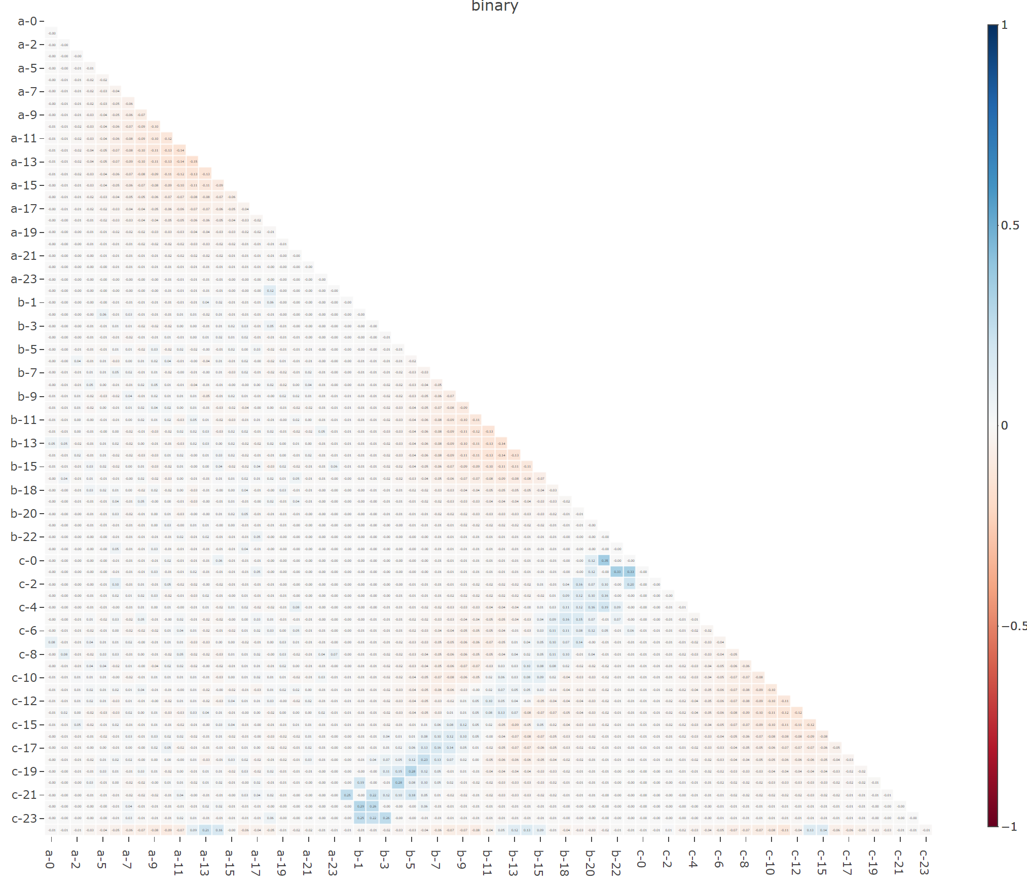
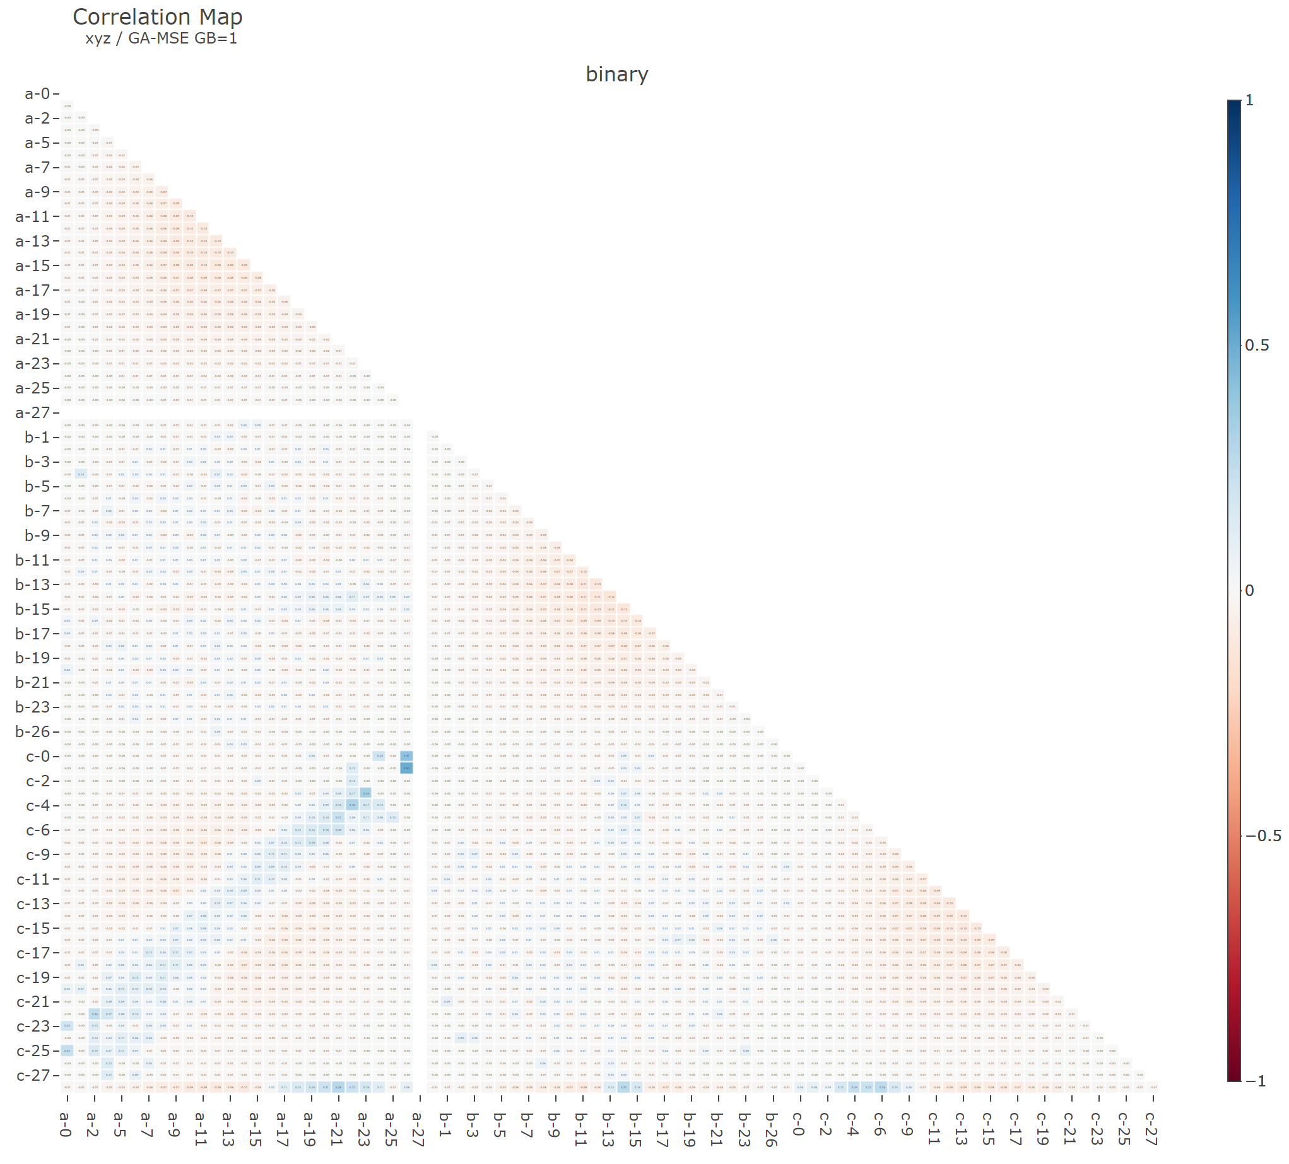
Slicing out empty binary column
Binary features: 69 | Binary features: 81

Slide 4
Binary Features | shape 1 | shape 2 | shape 3
50.
53.
56.
59.
62.
65.
68.
71.
74. |  |  | c-23
77.
80.
83. | b-26
86. | b-27 | a-27
89. | b-28 | a-28
92. | b-29 | a-29
95. |  | a-30
98. |  | a-31 | c-31
101. |  | a-31, a-32
104. |  | a-32, a-33
107. |  | a-33, a-34 | c-34
110. |  | a-34, a-35 | c-34, c-35
113. | b-36 | a-35, a-36 | c-35, c-36
116. | b-37 | a-36, a-37 | c-36, c-37
119. | b-38 | a-37, a-38 | c-37, c-38
122. | b-38, b-39 | a-38, a-39 | c-37, c-38, c-39
125. | a-40, b-39, b-40 | a-39, a-40, b-40 | c-38, c-39, c-40
128. | a-41, b-40, b-41 | a-40, a-41, b-41 | c-39, c-40, c-41
131. | a-41, a-42, b-41, b-42 | a-41, a-42, b-42 | c-41, c-42
134. | a-42, a-43, b-42, b-43 | a-42, a-43, b-43, c-43 | c-42, c-43
137. | a-43, a-44, b-43, b-44 | a-43, a-44, b-44, c-44 | c-43, c-44
140. | a-44, a-45, b-44, b-45 | a-43, a-44, a-45, b-45, c-45 | c-44, c-45
143. | a-45, a-46, b-45, b-46 | a-44, a-45, a-46, b-46 | c-42, c-43, c-44, c-45, c-46
146. | a-46, a-47, b-46, b-47 | a-45, a-46, a-47, b-47, c-47 | c-44, c-45, c-46, c-47
149. | a-47, a-48, b-47, b-48 | a-45, a-46, a-47, a-48, b-48, c-48 | c-45, c-46, c-47, c-48
Notes:
Drop zero column

Slide 5
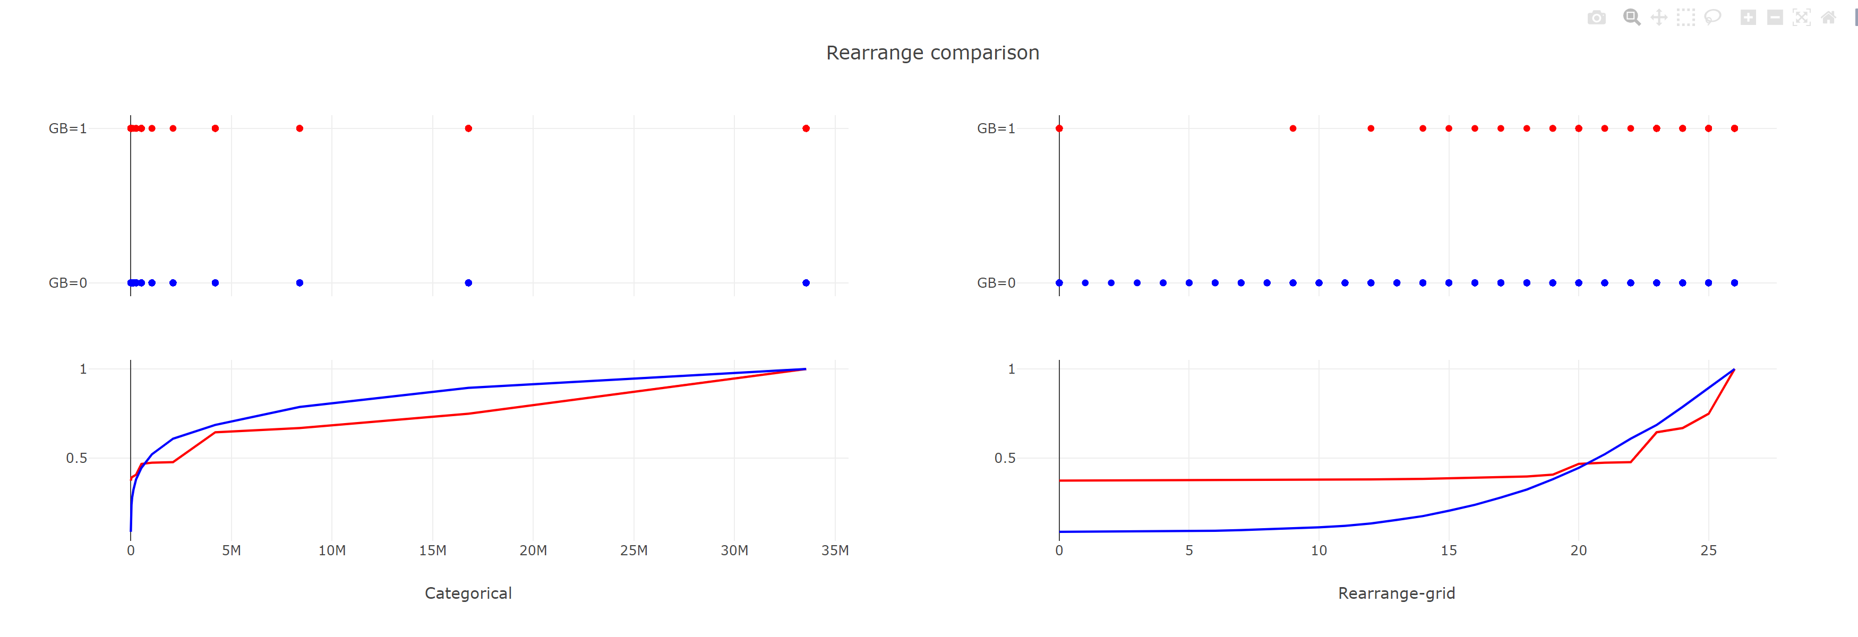
Rearrange encoded DataFrame
Rebuilt grid-like data
Level distance gaps cause by difference in columns sequencing

Slide 6
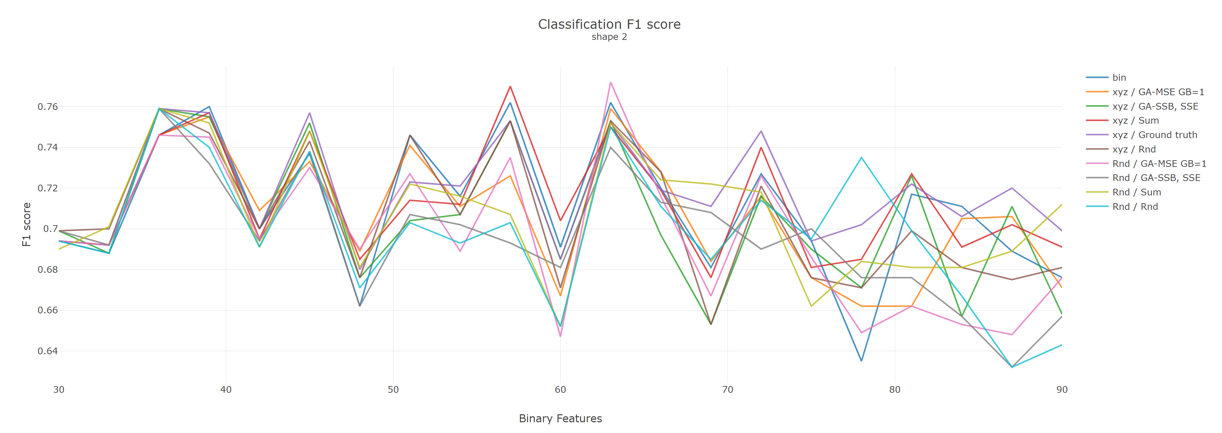
Classification results
Notes:
Pattern, 分類的結果, 誰沒有匡列

Slide 7
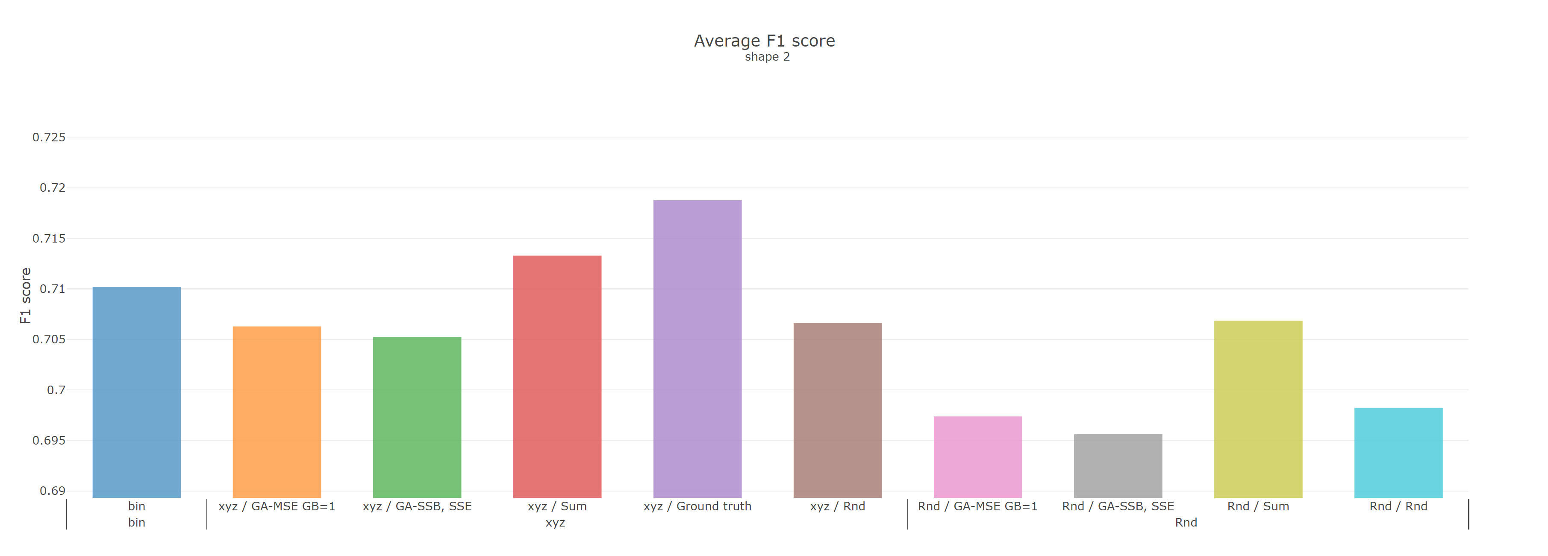
Classification average
Notes:
Check fitness
zero column ➔ Drop
Wave pattern, 分類的結果, 誰沒有匡列

Slide 8
Weekly Progress
Classification comparison between different shapes, and axis-rearrange methods
Drops out Empty columns if exist in binary data frame
Adding PCA columns grouping into comparison
Checks fitness calculation
Considering different data generations
New fitness functions
Notes:
Fitness
Overlap transform

Slide 9
Random in [0,2^k]
Rnd. data
Binary data
Column Grouping
PC-n X, Y ,Z Rnd
slicing
Cont. data
Encoding each column group
Unsupervised | Column attribute | ➔ | Sorting rule | ➔ | Encoding methods
 | Column ID Sum (Avg) Rnd |  | Large to Small Small to Large Normal dist. |  | Categorical Grid
supervised | GA
Dim. reduced data
Rearrange
Classification
Notes:
X, Y, Z

Slide 10
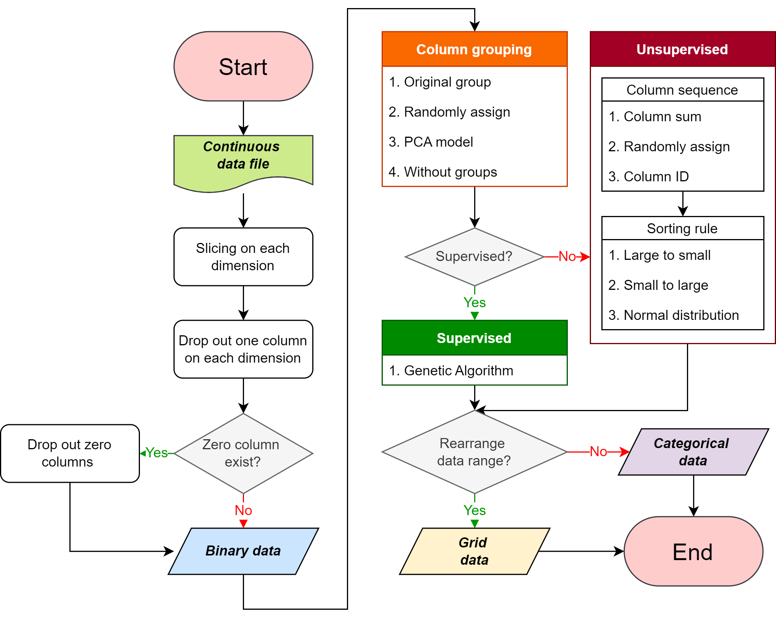

Slide 11
Structure flowchart
Dropout columns randomly until no Collinearity?
Dropout zero columns
Rearrange data range (categorical ➔ grid)
Notes:
Binary k-means
Inter-class correlation ICC
Binary correlation
Grouping methods

Slide 12
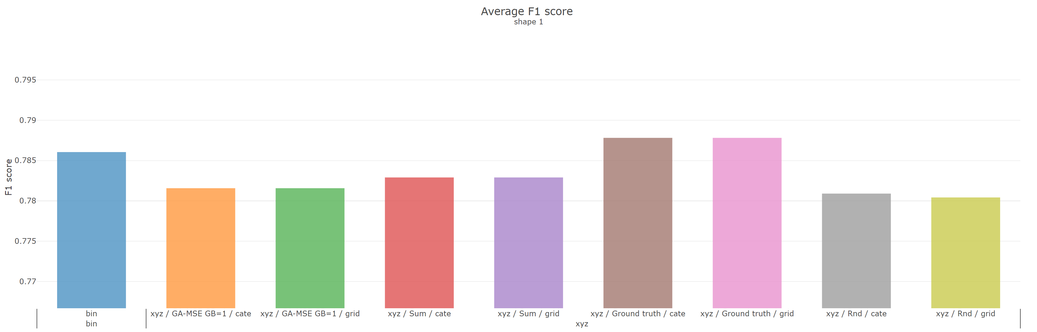
Rearrange axis range (gird vs. categorical)
Notes:
Recall, percision

Slide 13
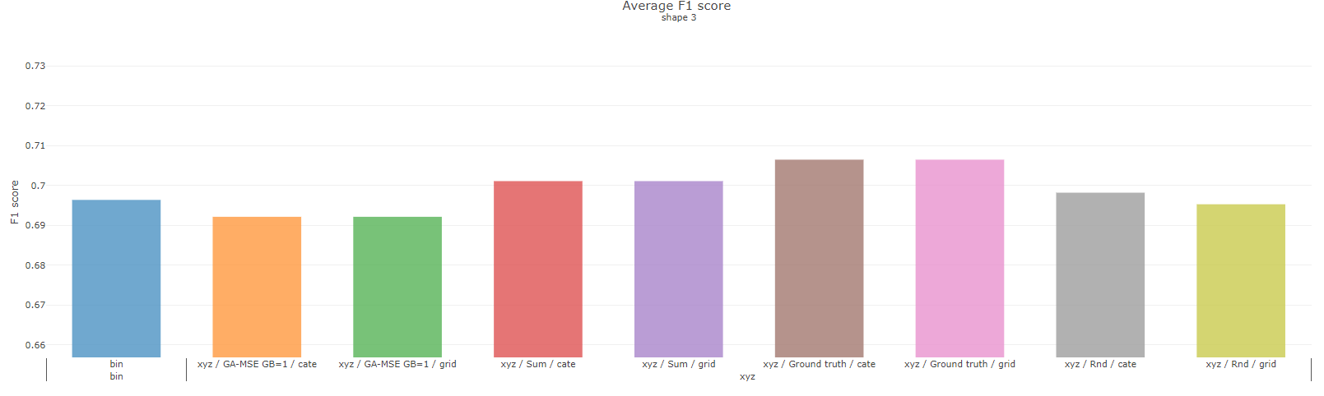

Slide 14
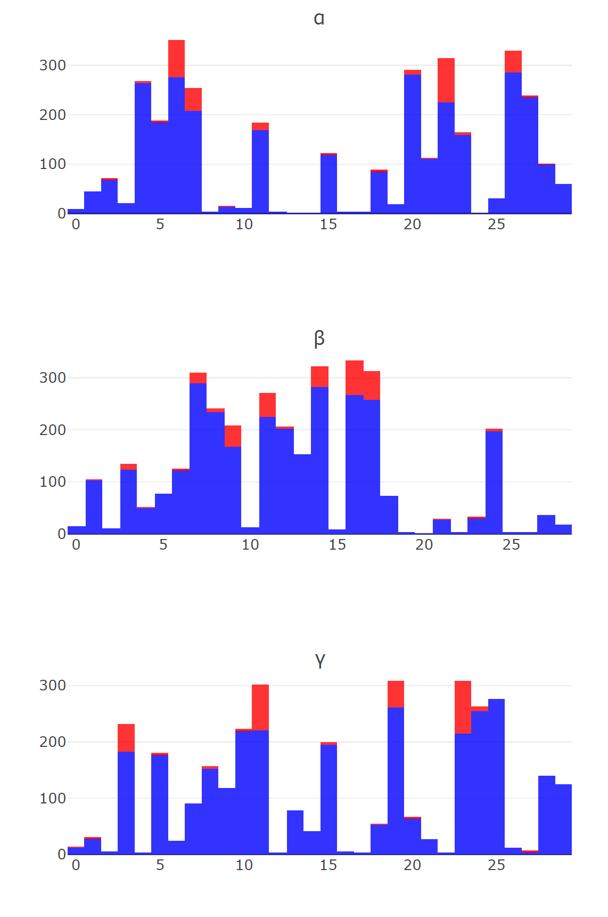
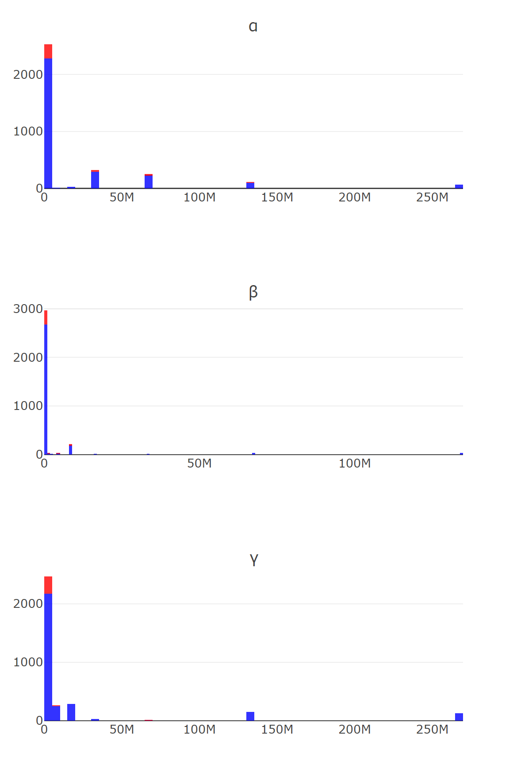
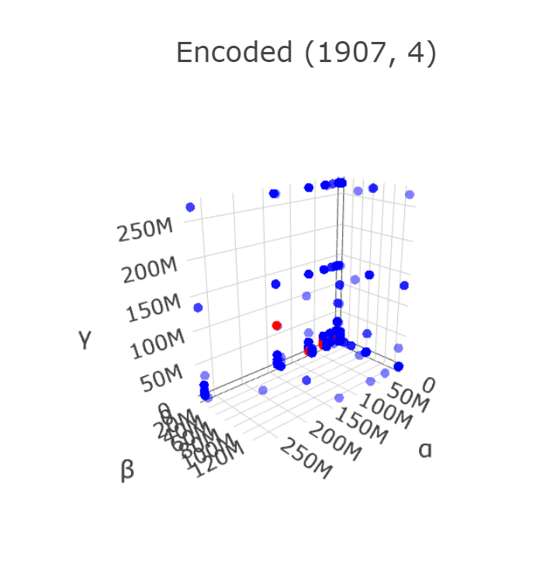
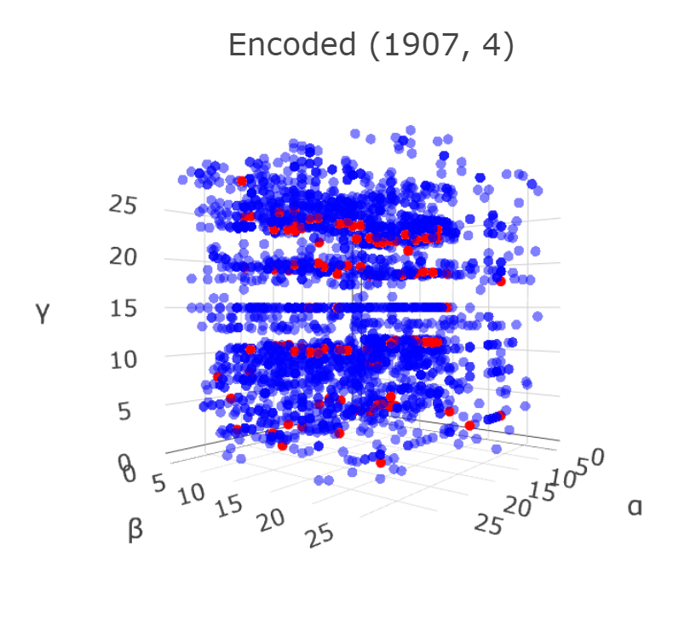

Slide 15
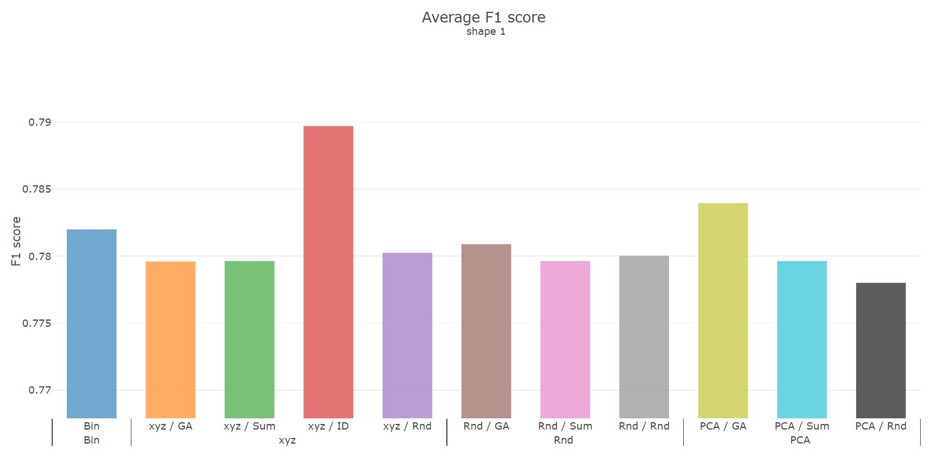
Classification comparison
Notes:
Pca abs

Slide 16
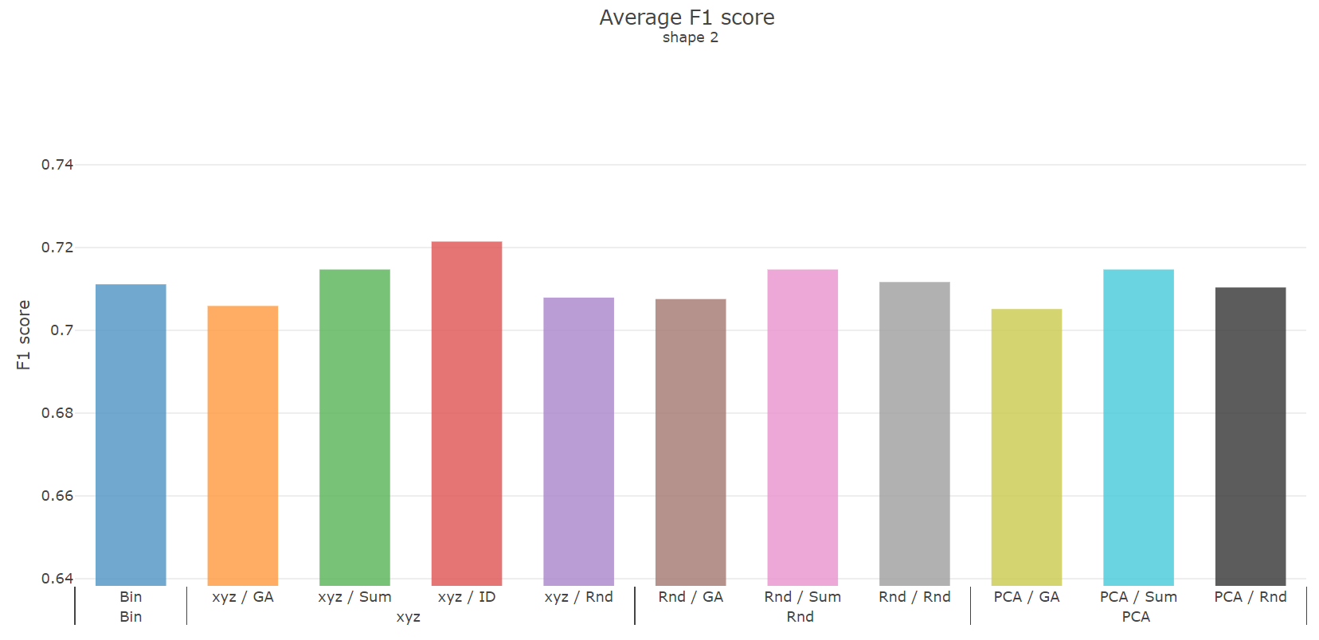

Slide 17
Grouping methods
Binary k-means
Inter-class correlation ICC
Binary correlation
Classification
Recall, precision
Overlap transform
PCA
Abs(weight)
GA
Fitness
Build GA model on each group

Slide 18
Weekly Progress - minor fix
PCA
by ABS(weights)
Classification
Record F1, Recall, and precision
Overlap transform
Grouping methods
Grouped Dataframe read-in fix
Notes:
Fitness
Overlap transform

Slide 19
Weekly Progress - new approaches
Classification comparison between different shapes, and axis-rearrange methods
Grouping methods
Grouping columns by binary correlation
Rearrange column value with type knowledge
Another supervise method

Slide 20
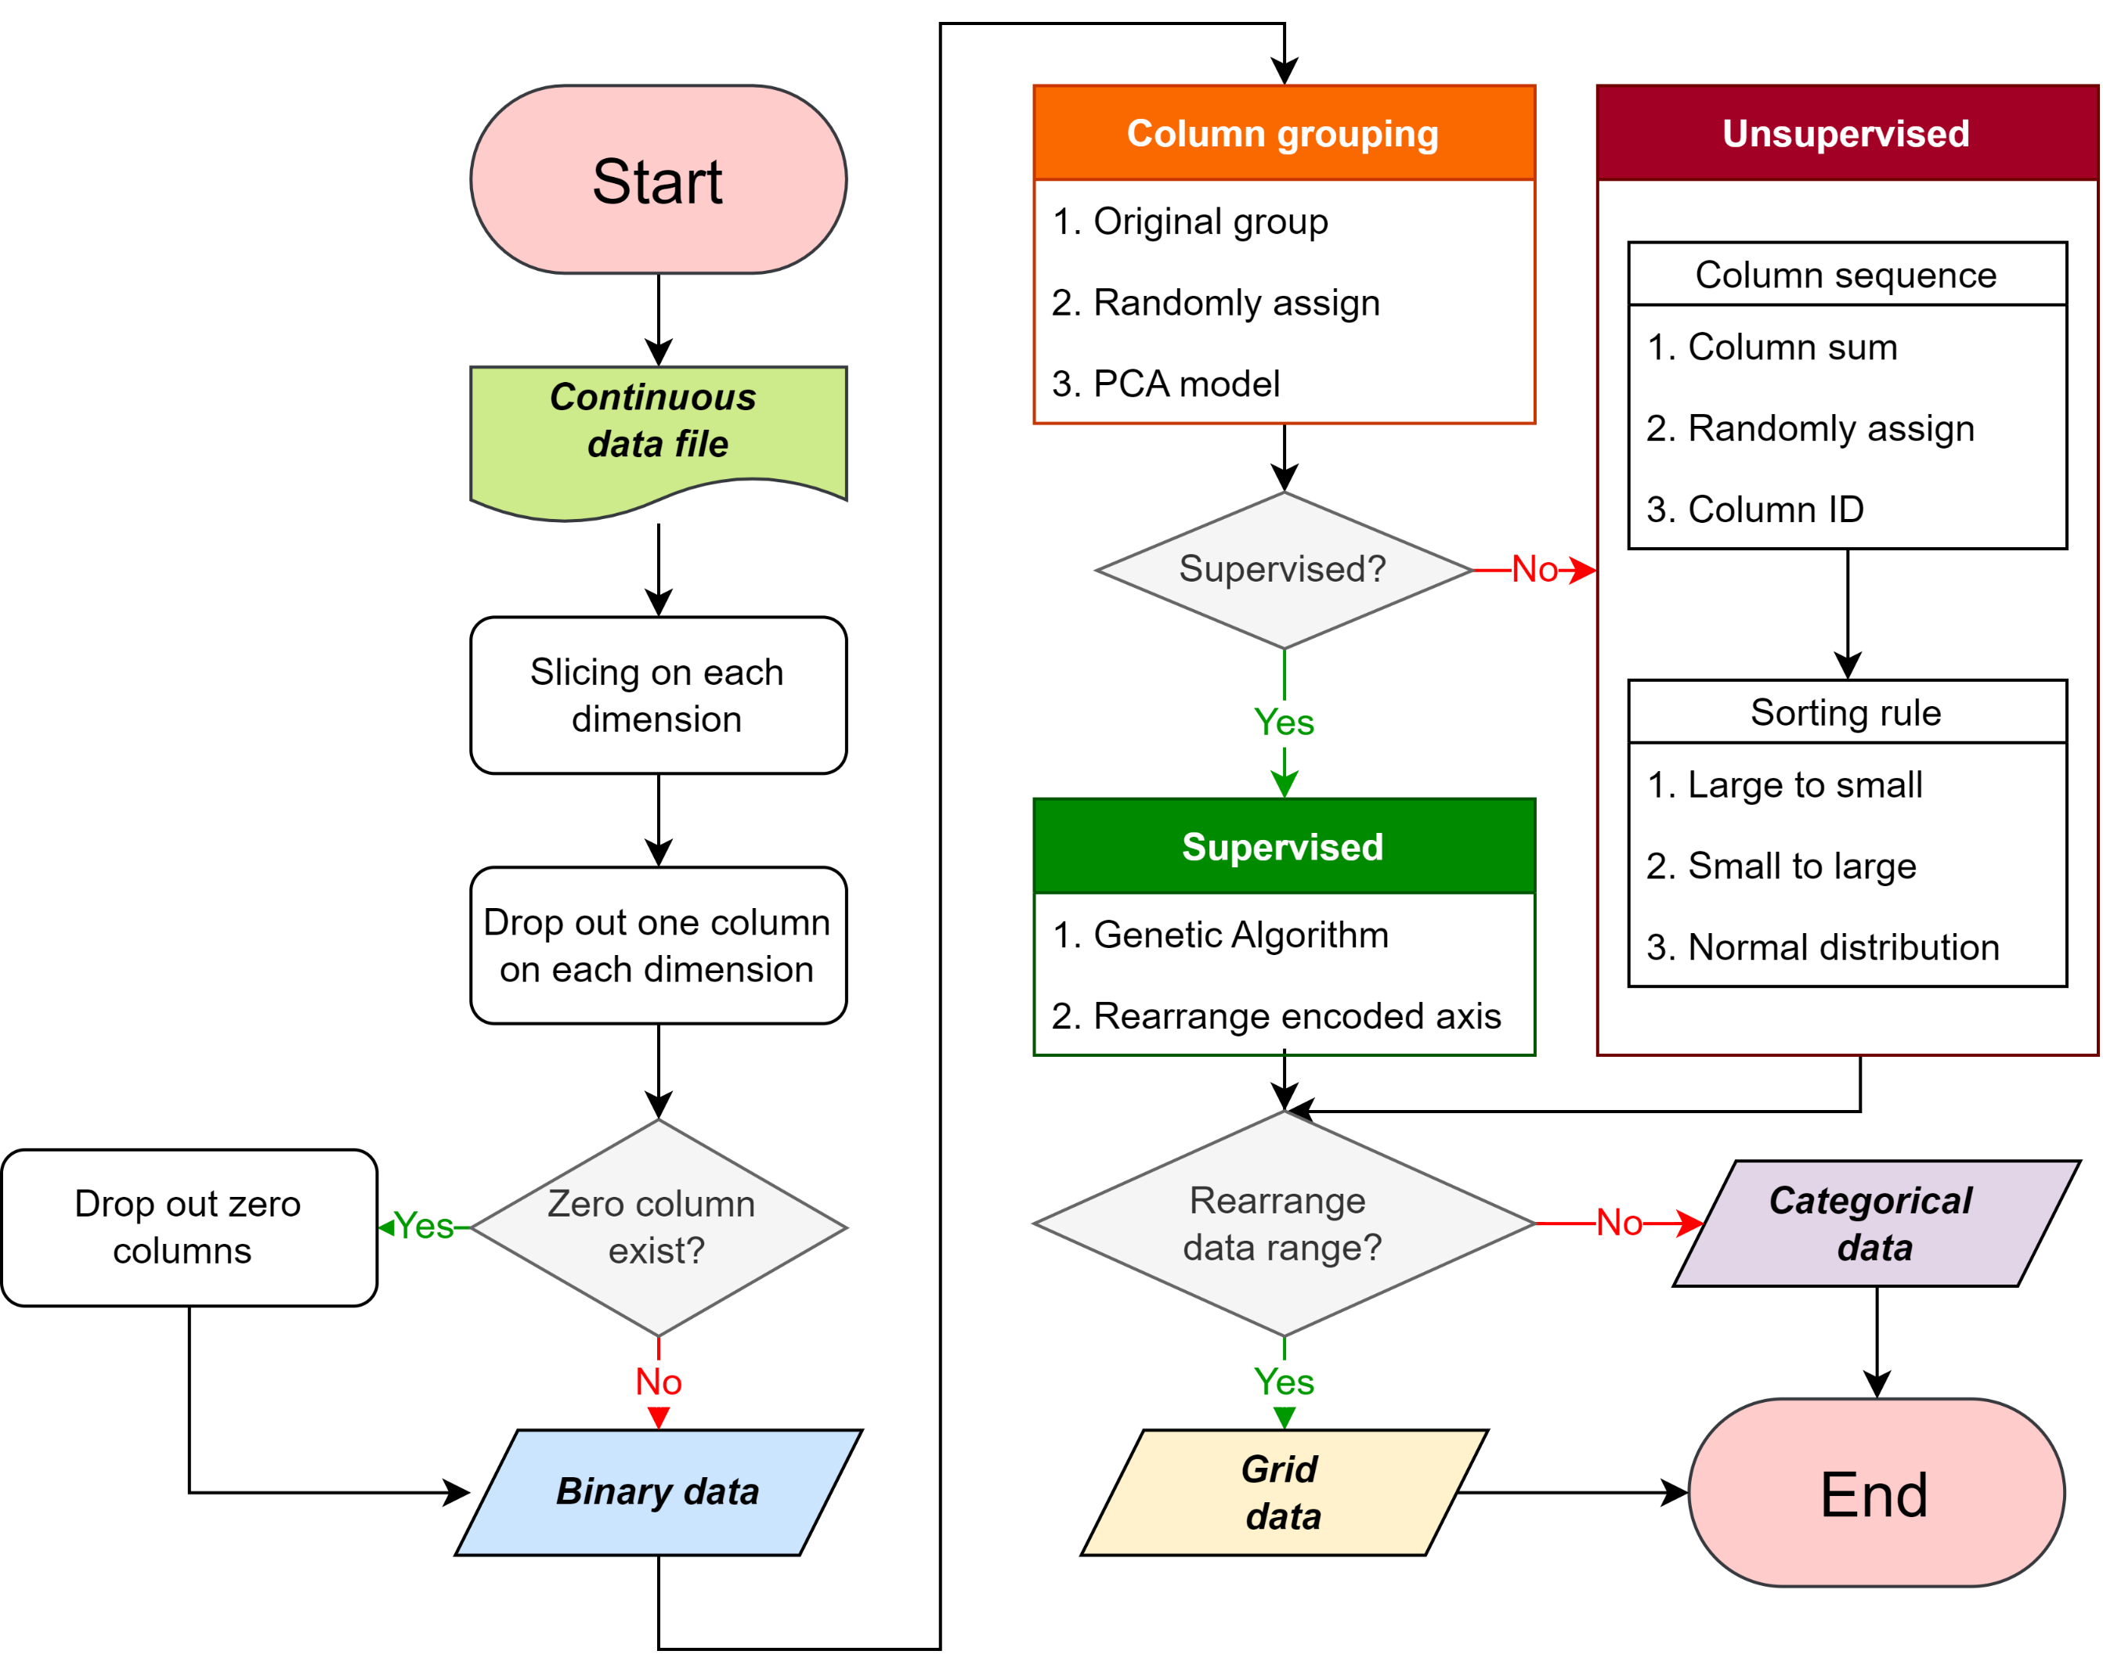

Slide 21
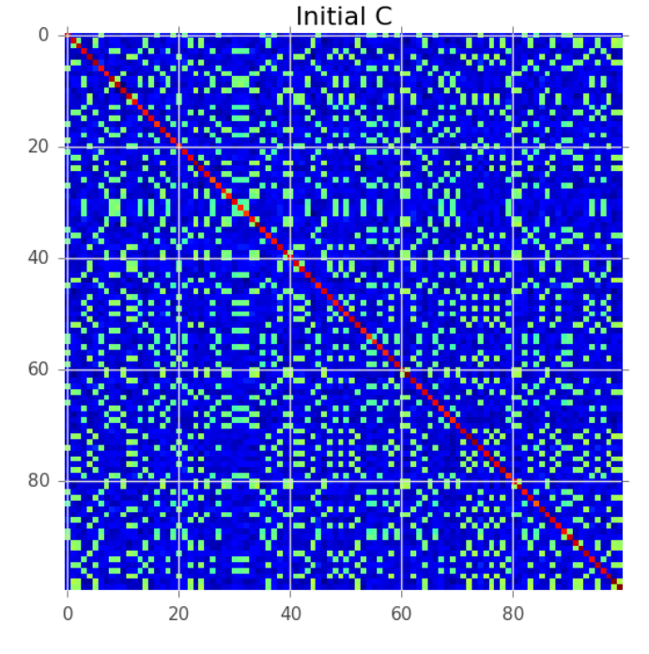
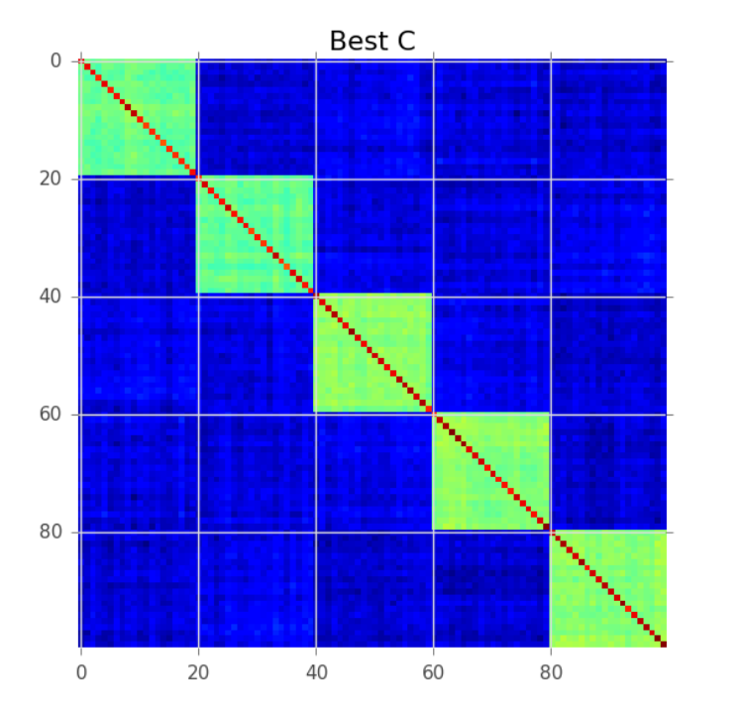
Correlation columns grouping
Initial correlation map |  | After clustering
High correlations within a cluster improve the score.
High correlations between clusters decease the score.

Slide 22
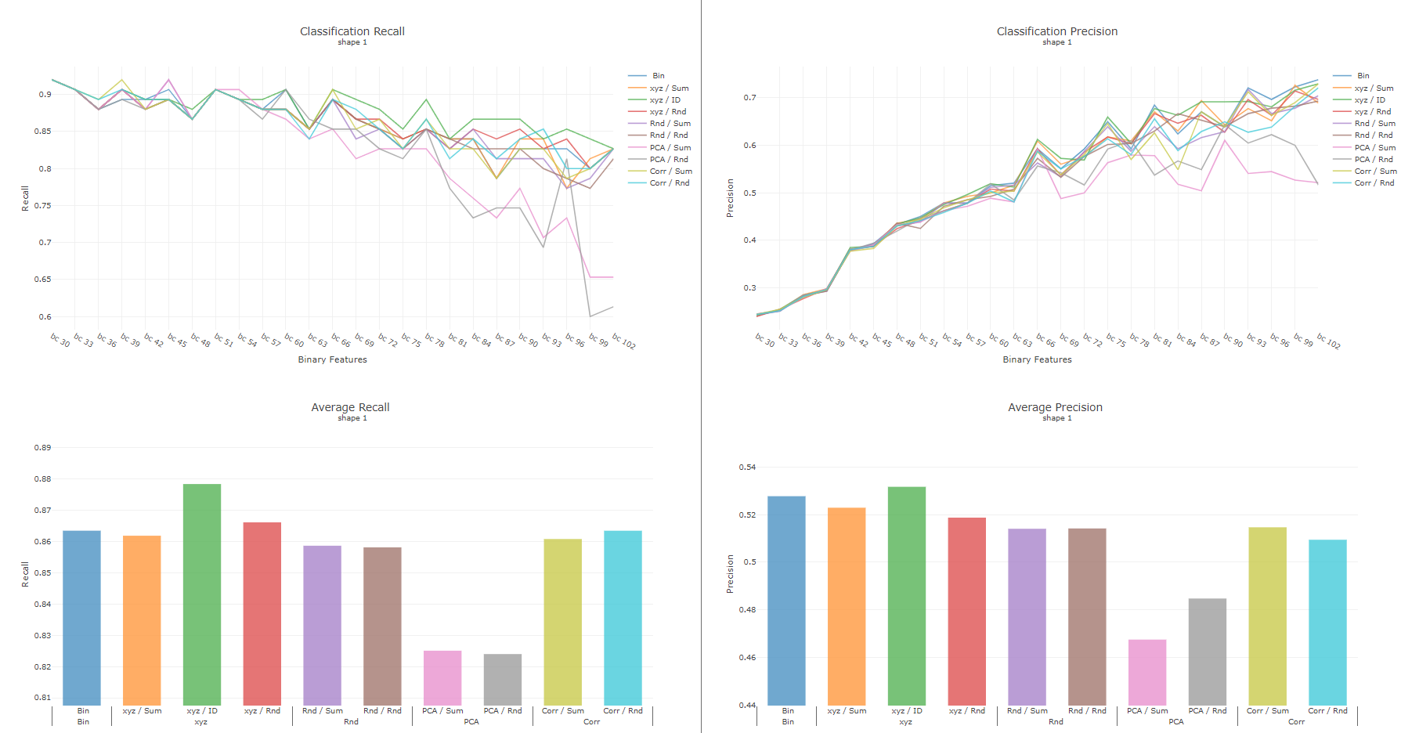
Shape 1
Recall | Precision

Slide 23
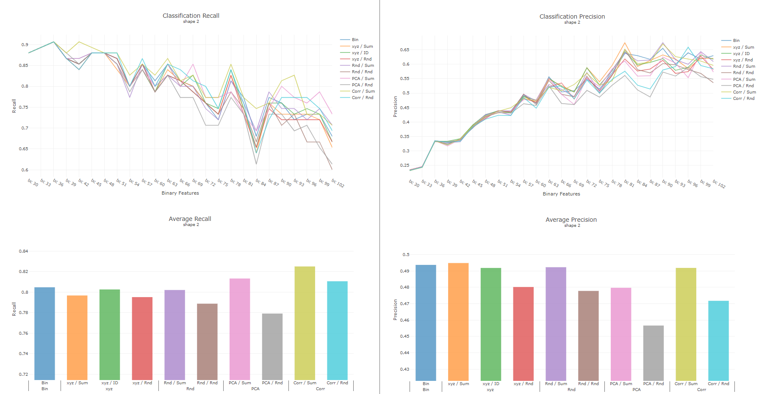
Shape 2
Recall | Precision

Slide 24
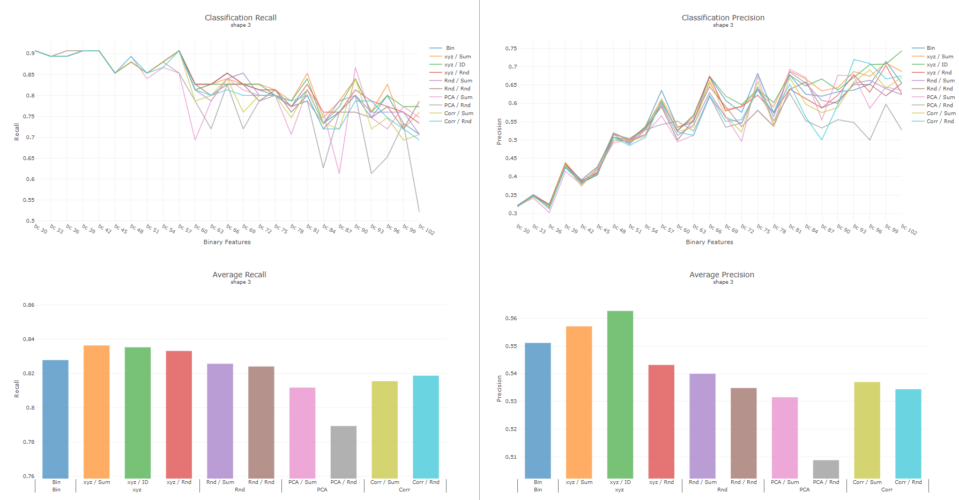
Shape 3
Recall | Precision

Slide 25
Rearrange encoded axis

Slide 26
Rearrange encoded column value
Sorting encoded categorical-column with data purity ratio

Slide 27
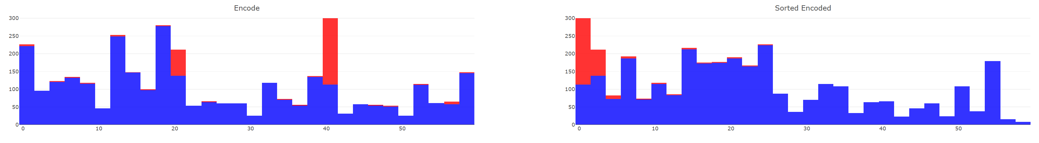
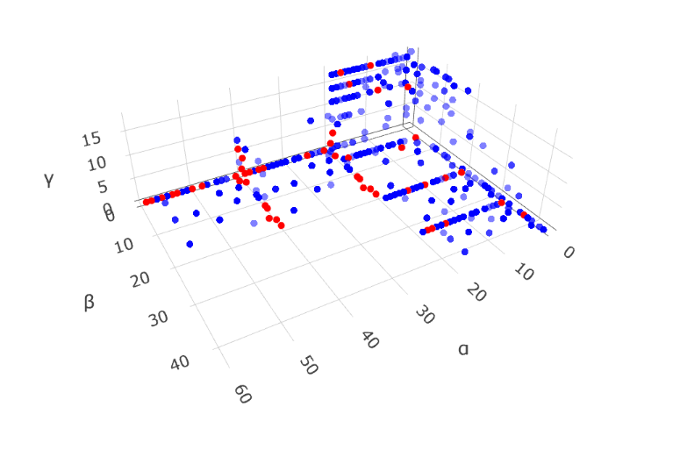
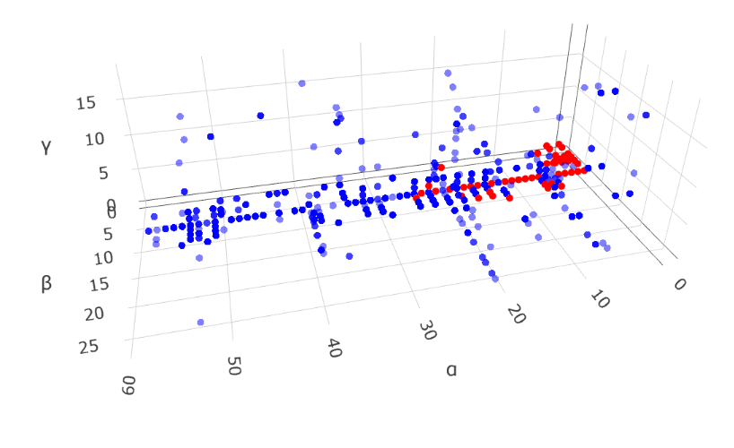
Rearrange encoded column value

Slide 28
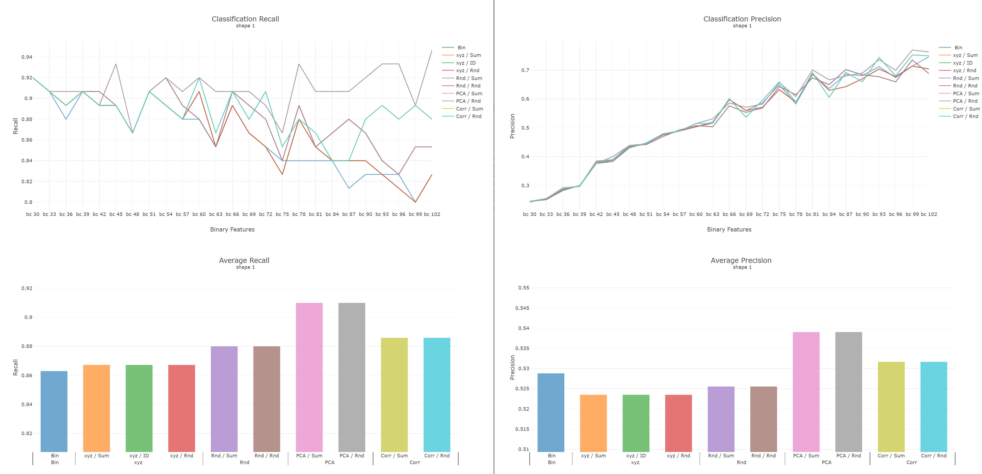
Shape 1
Recall | Precision

Slide 29
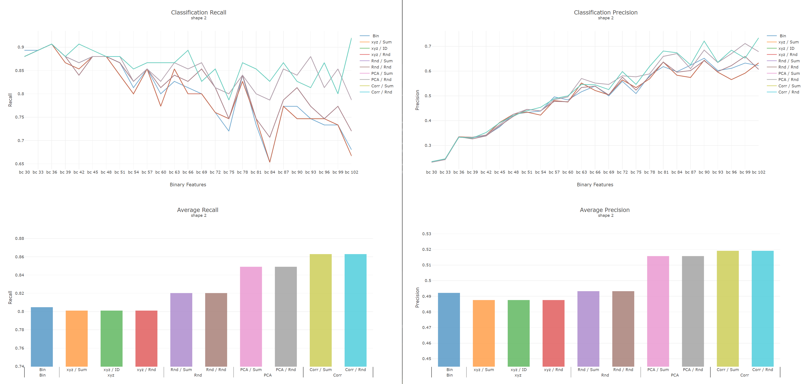
Shape 2
Recall | Precision

Slide 30
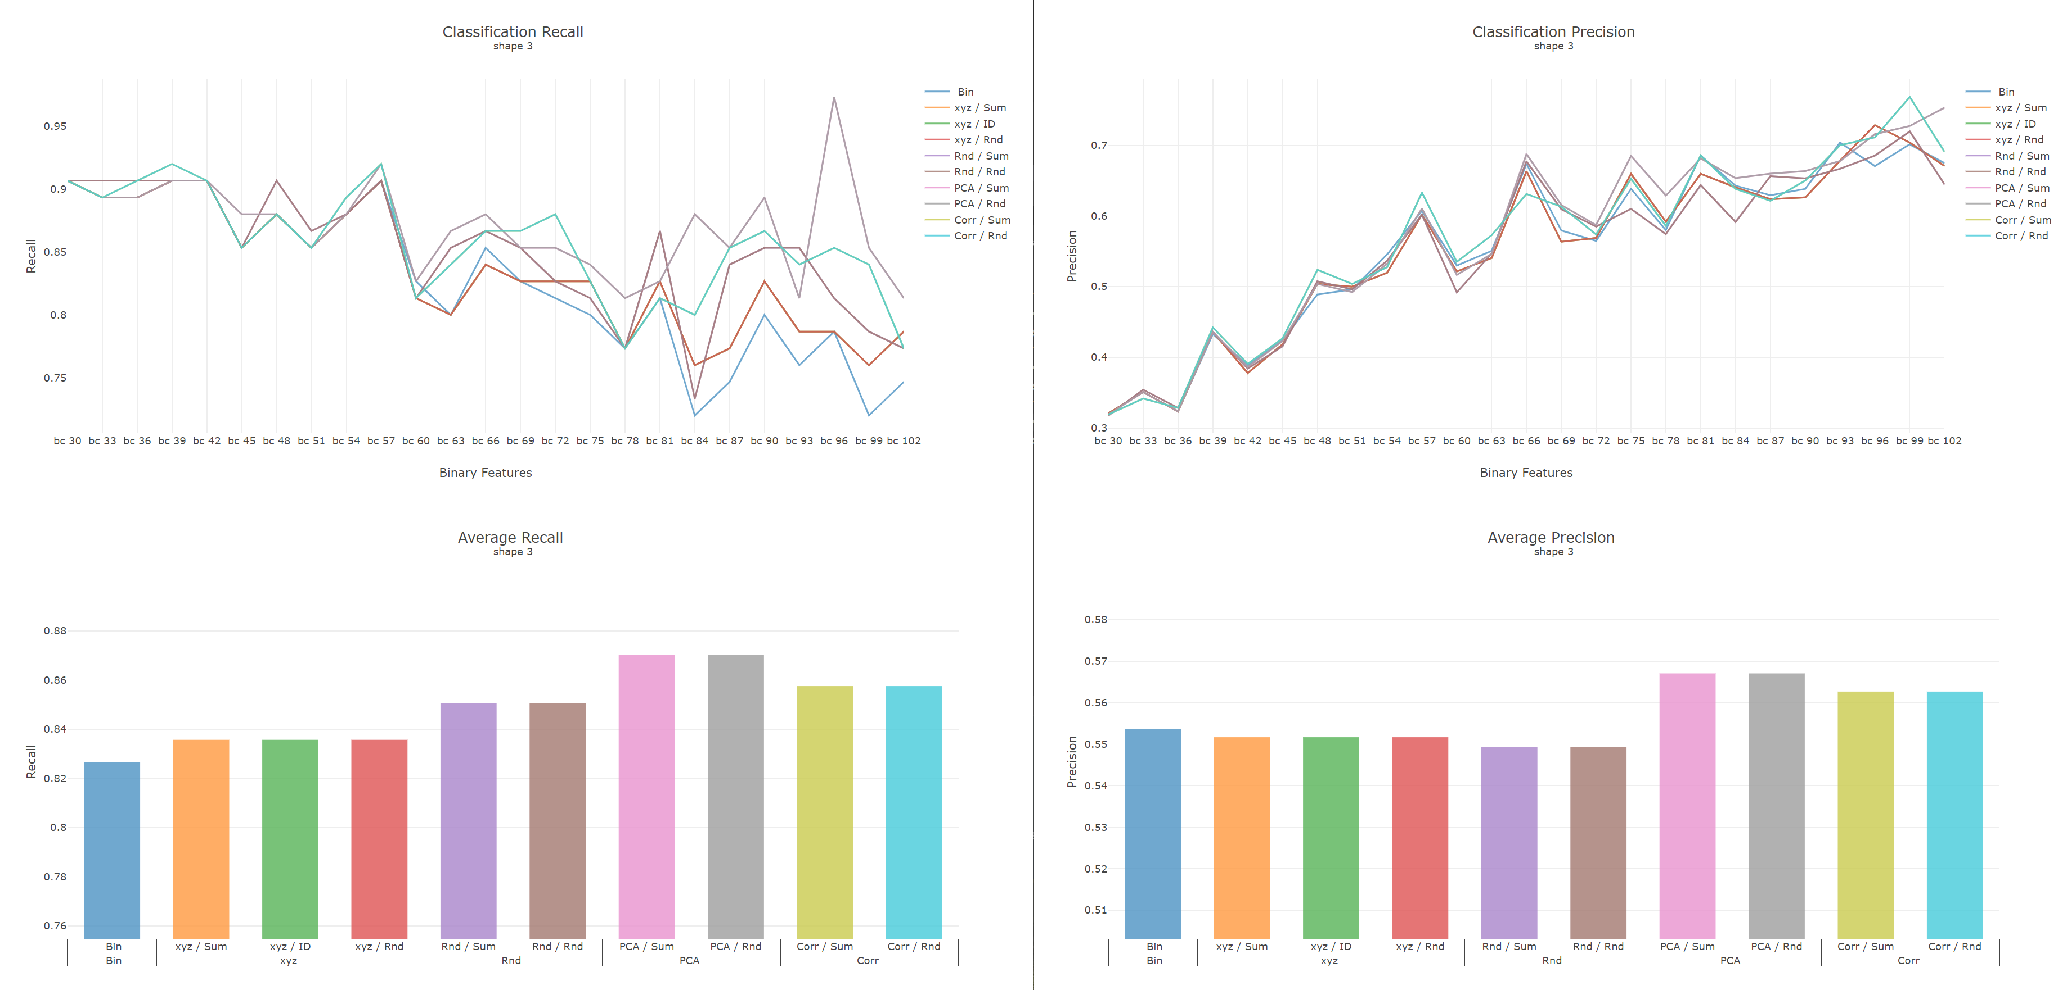
Shape 3
Recall | Precision

Slide 31
Classification
Split train , and test in first place
Lightgbm train on recall, not f1
Check encoded dataframe.uniques under different columns groups
Seq ➔ gini
DROP ONE ON EACH COL ON MIN(COL(1))
Notes:
Train ,test
Lightgbm train on recall, not f1
df.uniques
Seq ➔ gini
DROP ONE ON EACH COL ON MIN(COL(1))

Slide 32
Weekly Progress
Classification
Split train and test in first place
Lightgbm train on recall, not f1
Columns sequencing
Adding Gini impurity
Drop column randomly in each group ➔ drop minimum sum of column
Drop empty column first, then drop column on each axis
Literature review

Slide 33
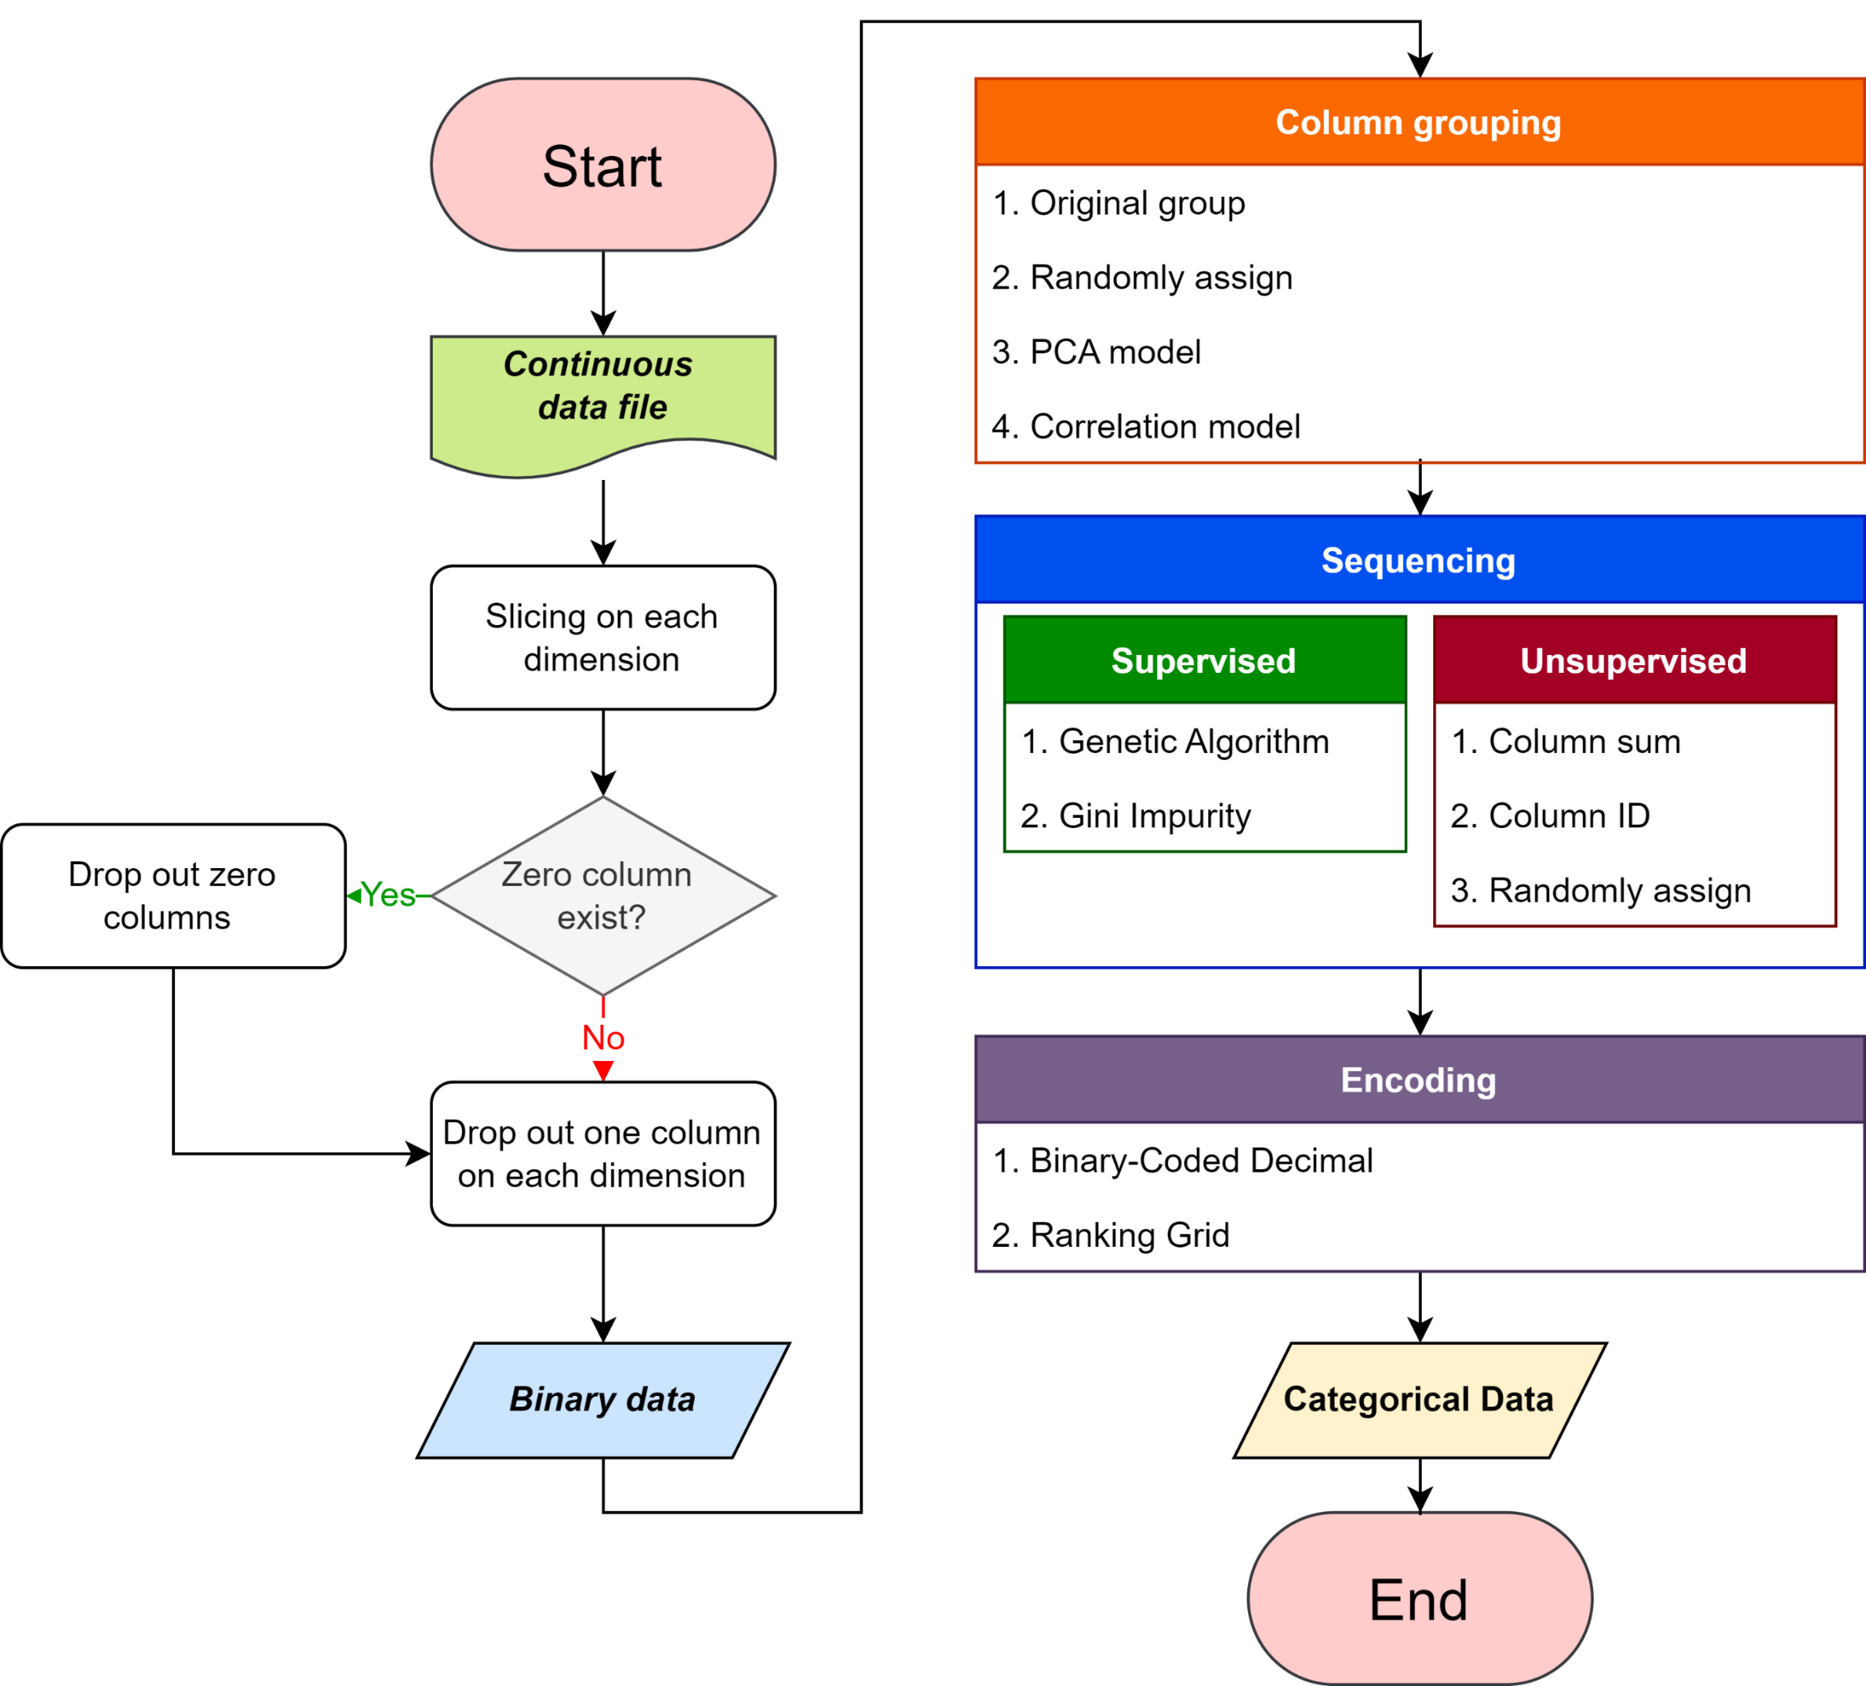

Slide 34
Sequencing column with Gini impurity.
A-1 | A-2 | A-3 | A-4 | A-5 | A-6 | A-7 | A-8 | A-9
A-8 | A-4 | A-6 | A-1 | A-9 | A-3 | A-2 | A-5 | A-7
Type Impurity

Slide 35
Sequencing column with Gini impurity.
A-1 | A-2 | A-3 | A-4 | A-5 | A-6 | A-7 | A-8 | A-9
A-2 | A-7 | A-3 | A-5 | A-6 | A-1 | A-8 | A-9 | A-4
Column sum
A-8 | A-4 | A-6 | A-1 | A-9 | A-3 | A-2 | A-5 | A-7
Type Impurity

Slide 36
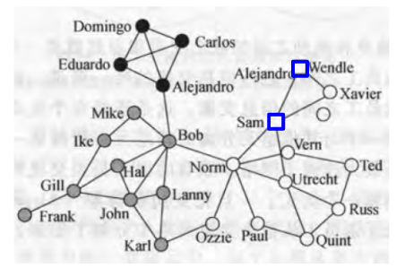
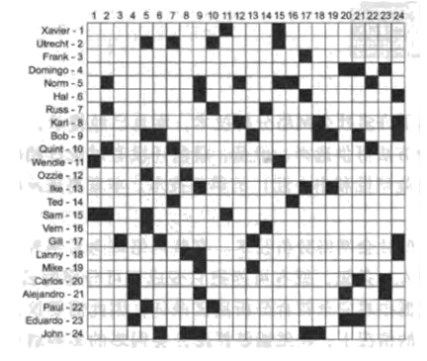
Block modeling
Doreian, P., Batagelj, V., & Ferligoj, A. (2005). Generalized blockmodeling (No. 25). Cambridge university press.

Slide 37
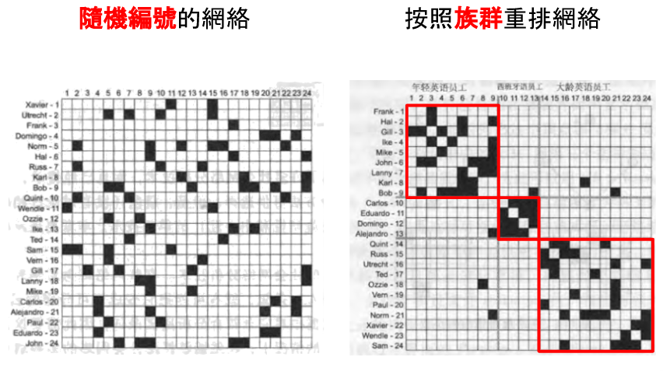
Block modeling
Notes:
階層

Slide 38
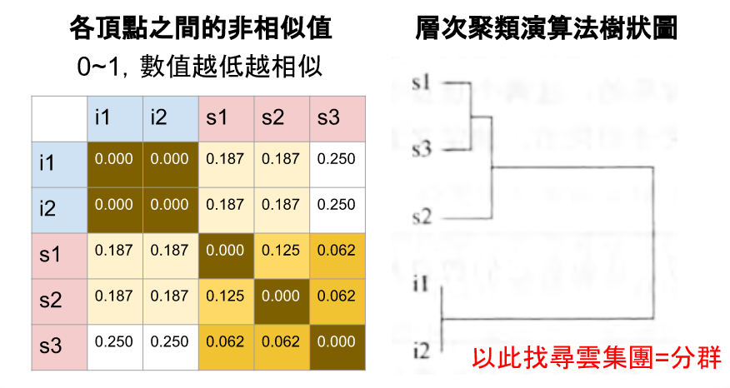
Block modeling

Slide 39
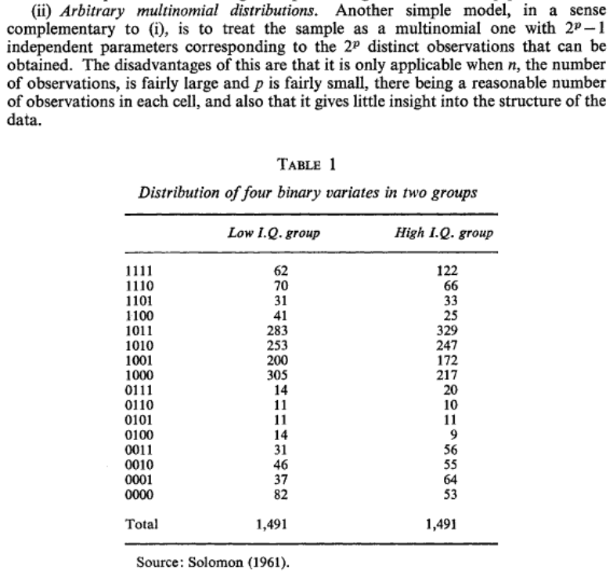
The Analysis of Multivariate Binary Data
Cox, D. R. (1972). The analysis of multivariate binary data. Applied statistics, 113-120.

Slide 40
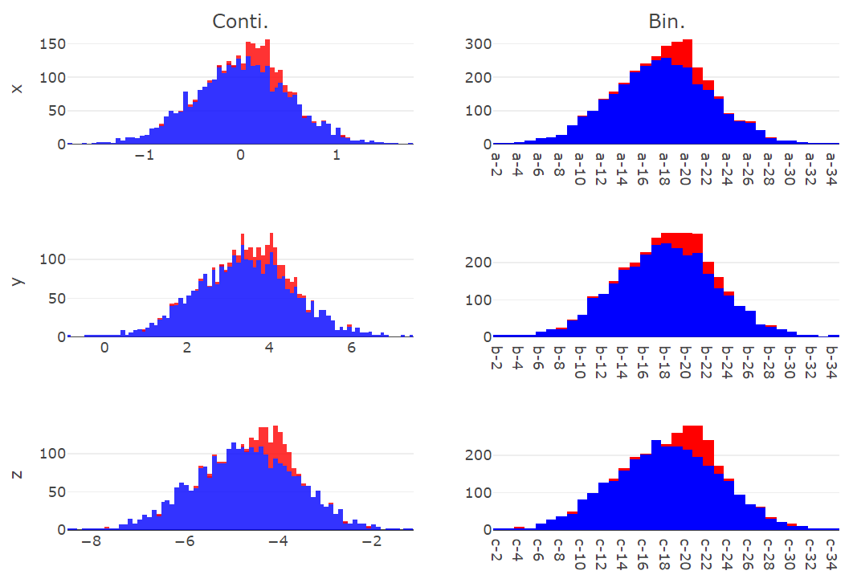
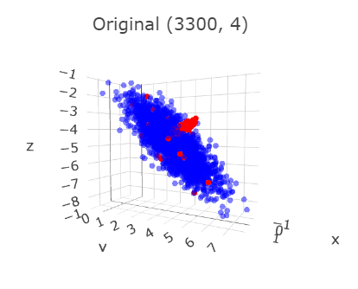
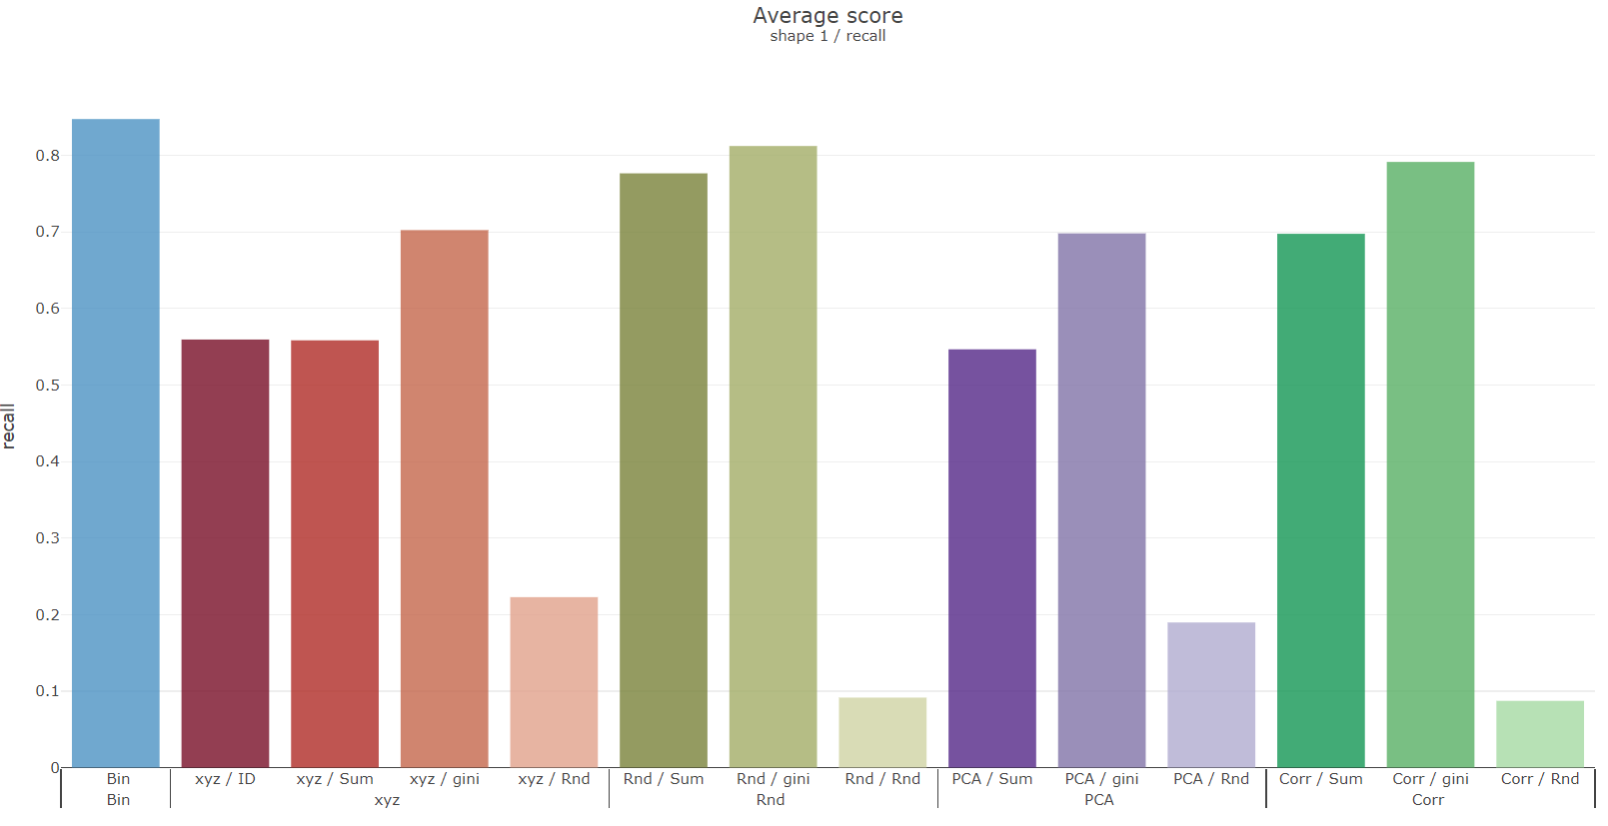
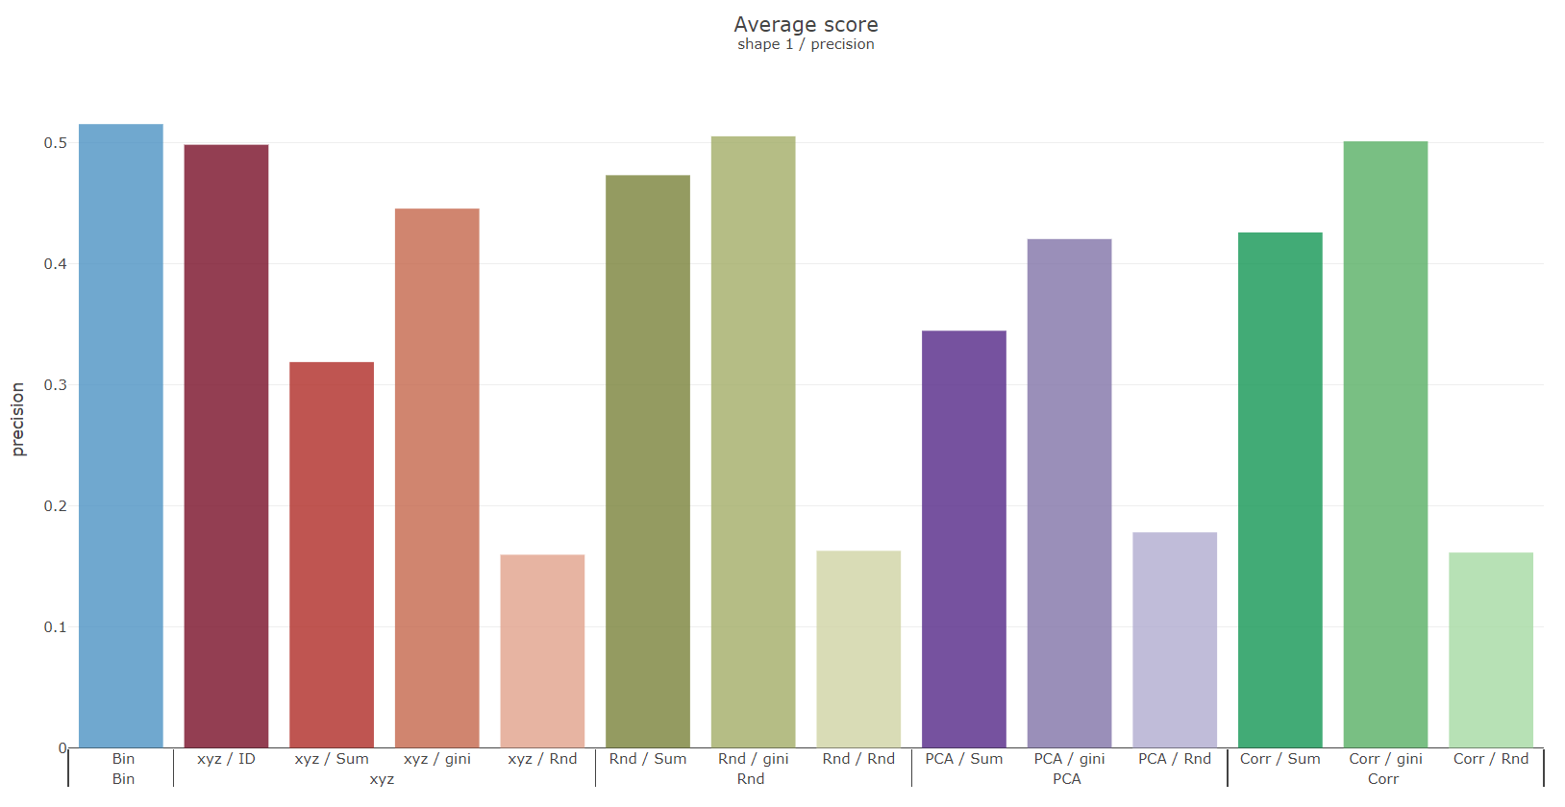
Shape 1

Slide 41
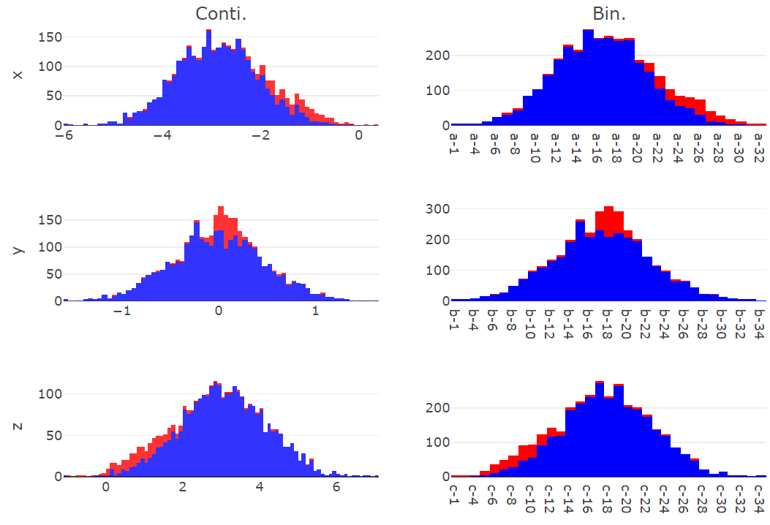
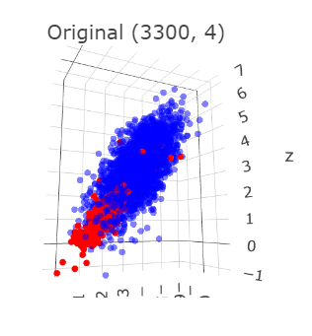
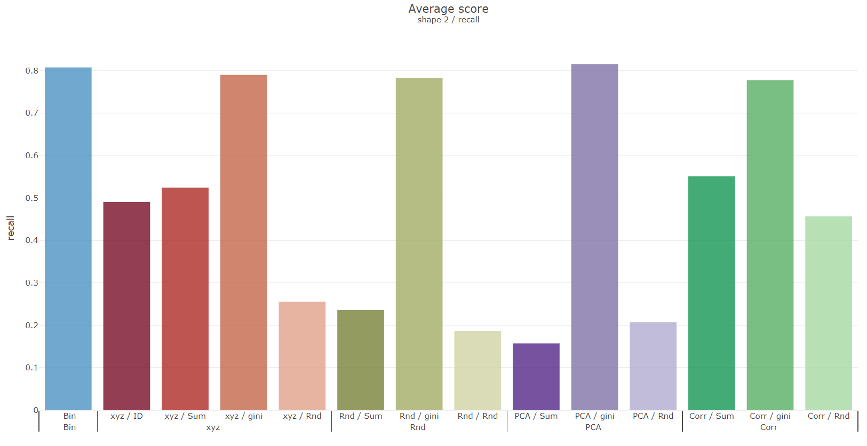
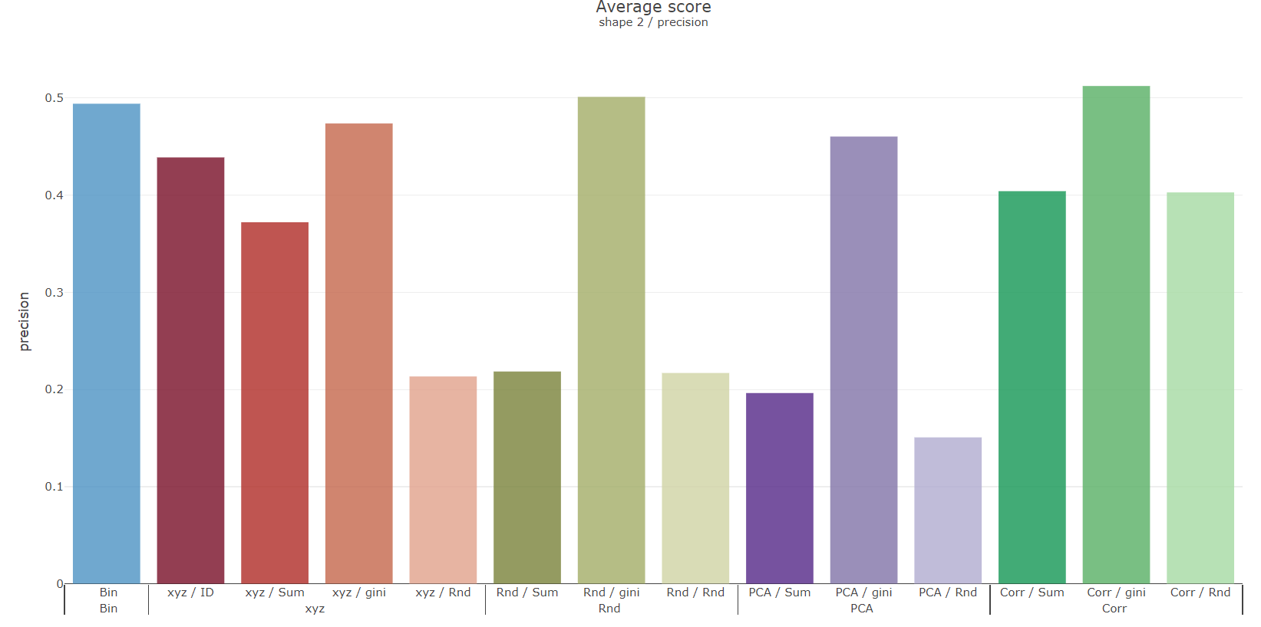
Shape 2

Slide 42
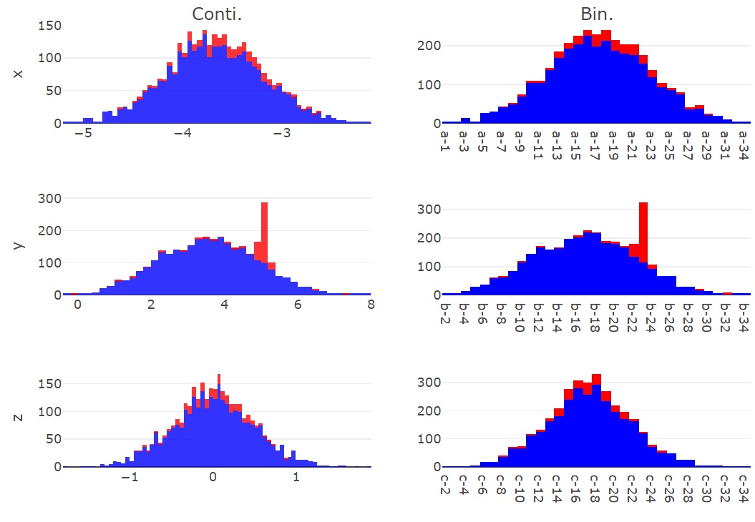
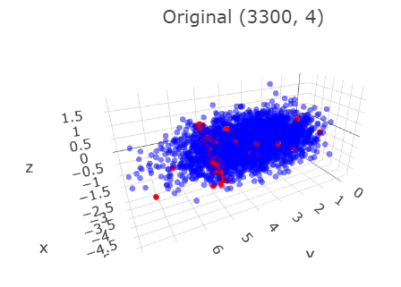
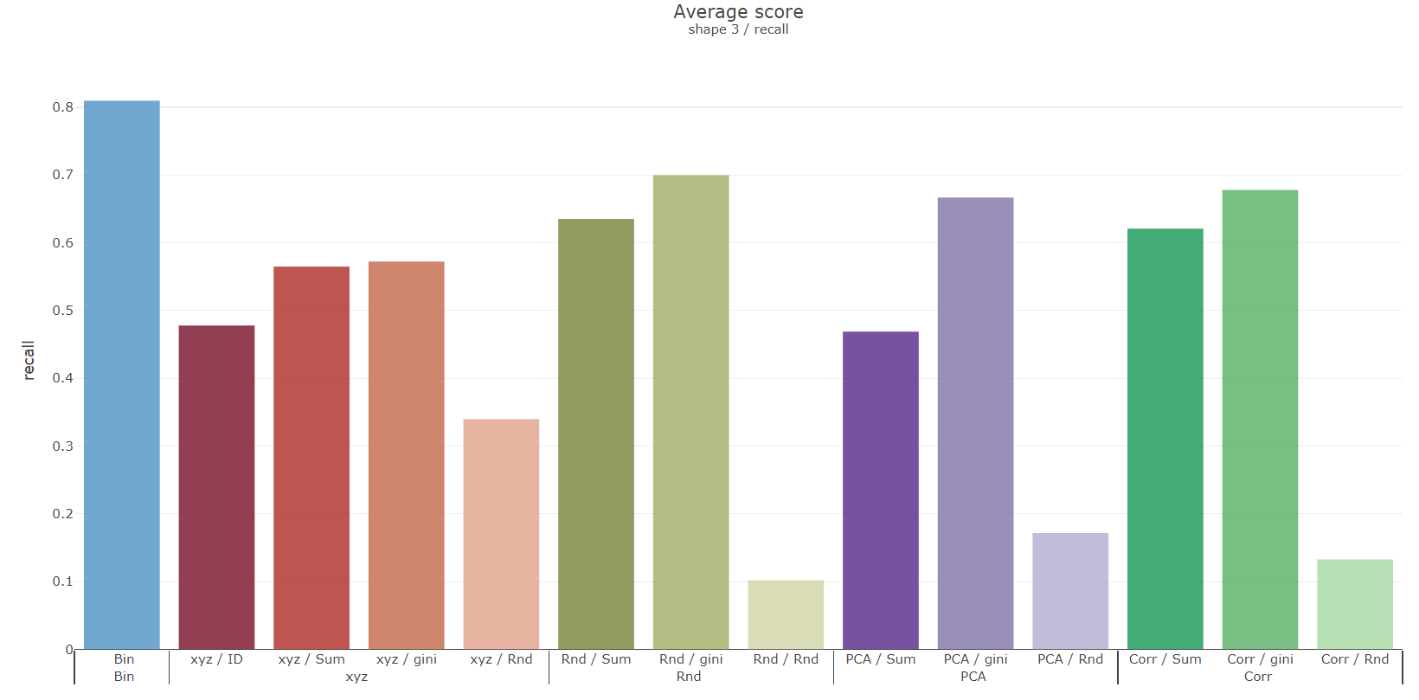
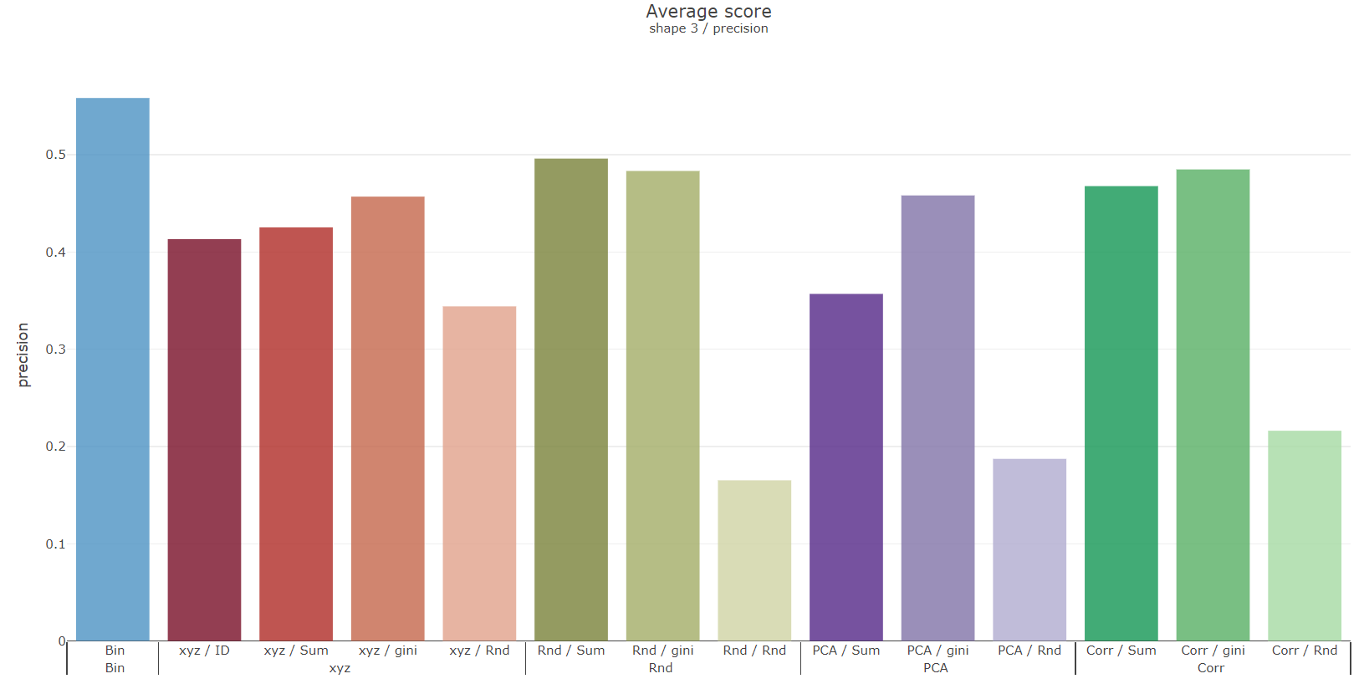
Shape 3

Slide 43
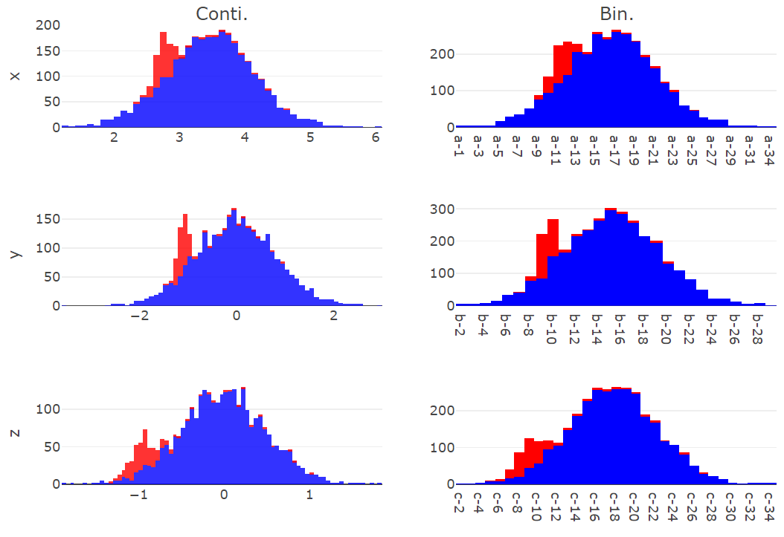
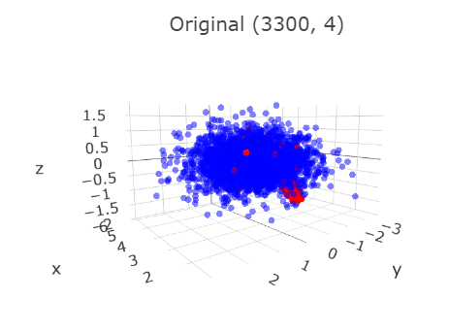
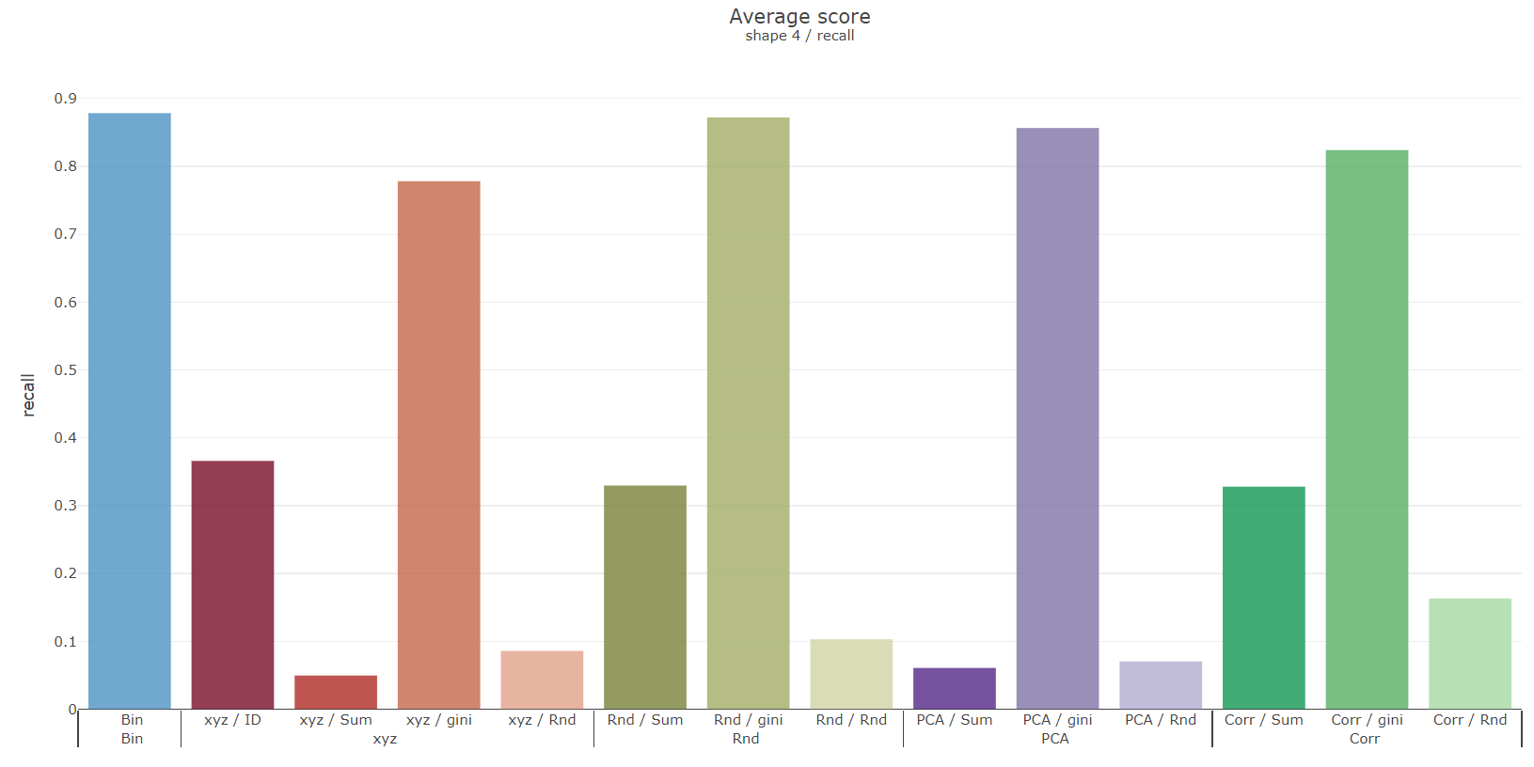
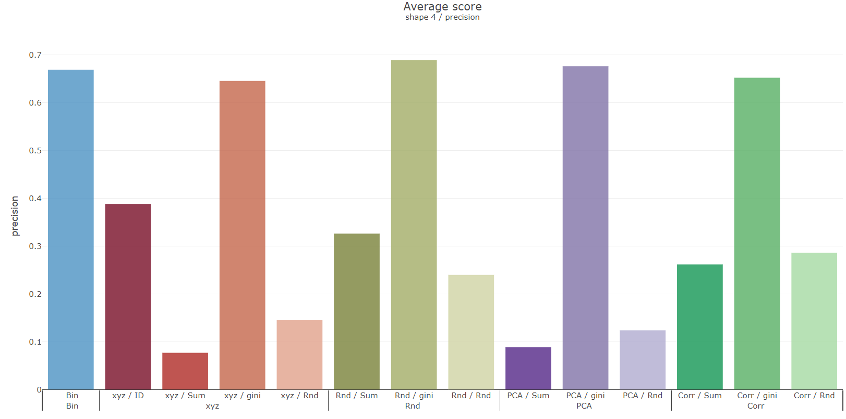
Shape 4

Slide 44
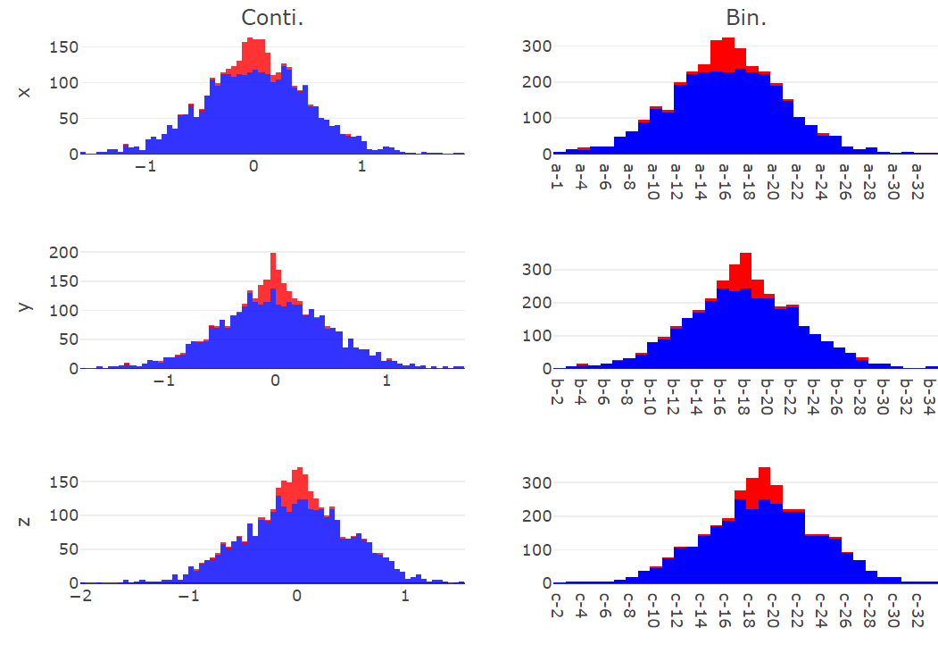
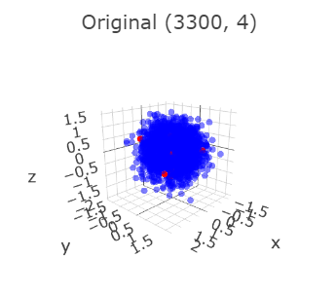


Shape 5
Notes:
K- fold
階層 聚類
相異column group
ABS(Correlation ), correlation^2

Slide 45
Weekly Progress
Classification
k-fold stratified cross validations
Correlation columns grouping
Corr, ABS(Corr), Corr^2
Higher difference correlation within group
Trying with classification benchmark problem?
Grouping with columns sequence?

Slide 46




Shape 1
 | Recall | Precision
Reverse
Original

Slide 47




Shape 2
 | Recall | Precision
Reverse
Original

Slide 48




Shape 3
 | Recall | Precision
Reverse
Original

Slide 49
Grouping with columns sequence
S sorting
G-1 | G-2 | G-3 | G-4 | G-5 | G-6 | G-7
G-14 | G-13 | G-12 | G-11 | G-10 | G-9 | G-8
G-15 | G-16 | G-17 | G-18 | G-19 | G-20 | G-21
Notes:
K-fold deviation
Hybird dataset(cont., binary)
UCI
確認遠端還是實體口試

Slide 50
Record K-fold deviation
Grouping with columns sequence
Testing hybrid dataset(both cont. and bin.) on UCI
Make sure remote or physical oral test

